Slide 1


Slide 2



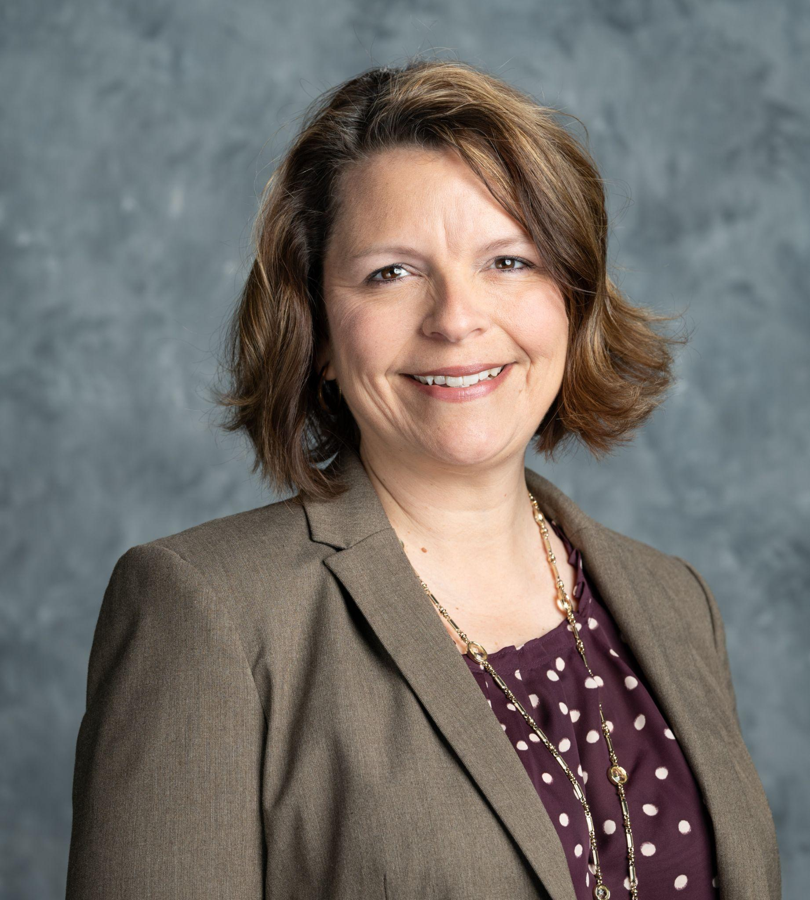

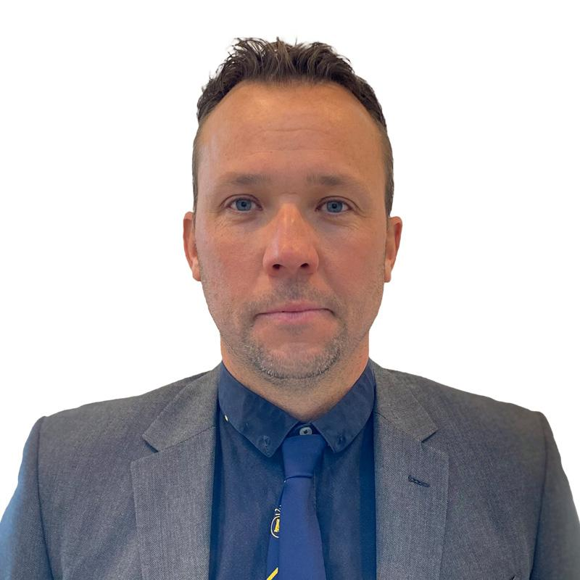
LINKS TO SUCCESS WEBINAR
Speakers
Sami Strutt
Education Director
Bernhard Academy
Leann Cooper
Director, First Green & Workforce Development GCSAA
Stuart Hall
Customer Care Manager
Bernhard and Company
Past Delegate - Vegas 2012
Richard Ponsford
Course Manager
Clevedon Golf Club
Past Delegate - Phoenix 2023

Slide 3

PROGRAM
OVERVIEW
PAST DELEGATE EXPERIENCE

Slide 4
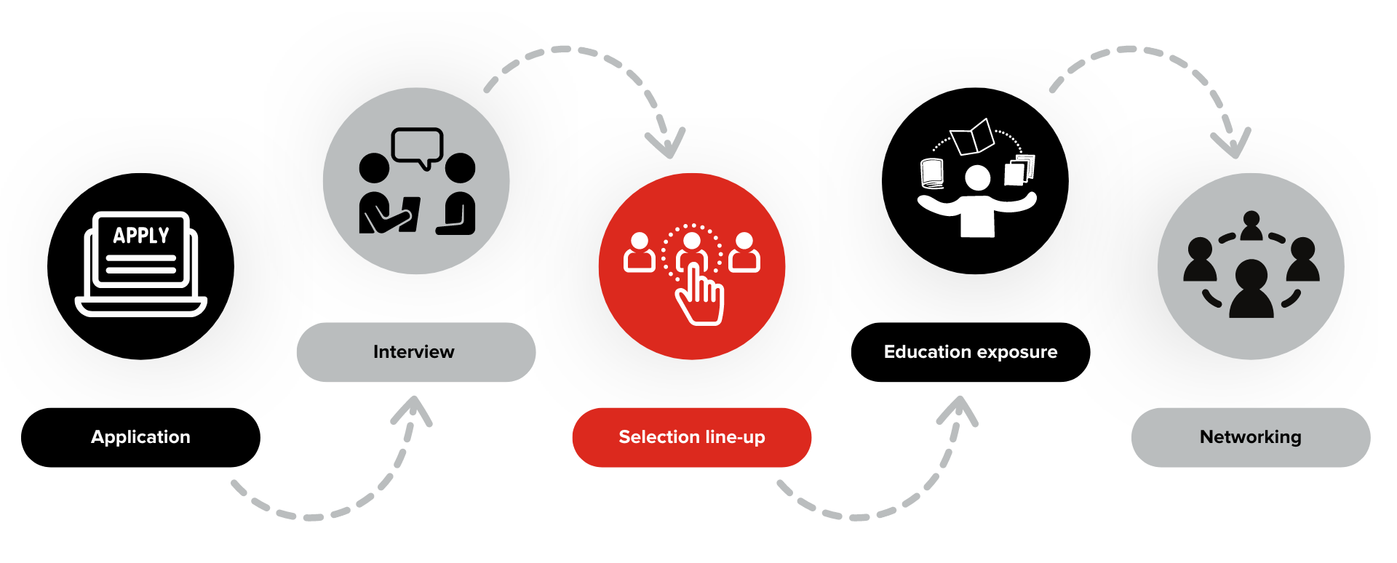
LINKS TO SUCCESS WEBINAR
Delegation Process

Slide 5
LINKS TO SUCCESS WEBINAR
Itinerary
SAT JAN 18
FLIGHT IN
Atlanta, GA to Manchester, England
SUN JAN 19
SITE VISITS
North England
MON JAN 20
SEMINARS
Harrogate, England
TUE JAN 21
SEMINARS
Harrogate, England
WED JAN 22
TRADE SHOW, VIP SEMINAR AND RECEPTION
Harrogate, England
THU JAN 23
SITE VISITS
North West England
FRI JAN 24
SITE VISITS
North West England
SAT JAN 25
FLIGHT OUT
Manchester, England to Atlanta, GA

Slide 6
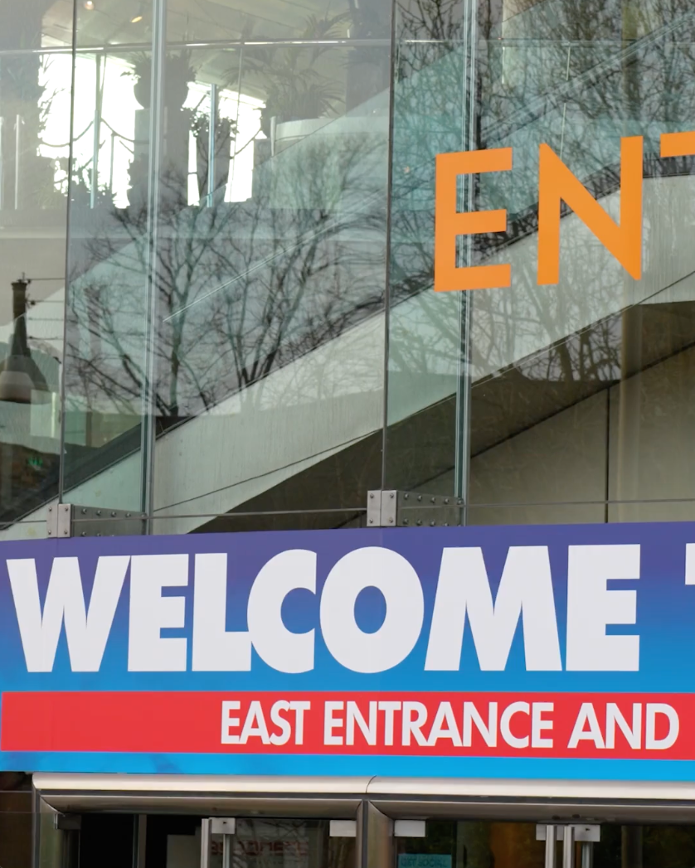
LINKS TO SUCCESS WEBINAR
BTME

Slide 7






LINKS TO SUCCESS WEBINAR
What’s Included
✔️ Included:
❌ Not included:
Flights
Transport
Accommodation
Breakfast & Evening Meals
Drinks & Nights Out
Tourist Destinations
Transport to Local Airport

Slide 8
PAST
DELEGATE
EXPERIENCES
PAST DELEGATE EXPERIENCE

Slide 9
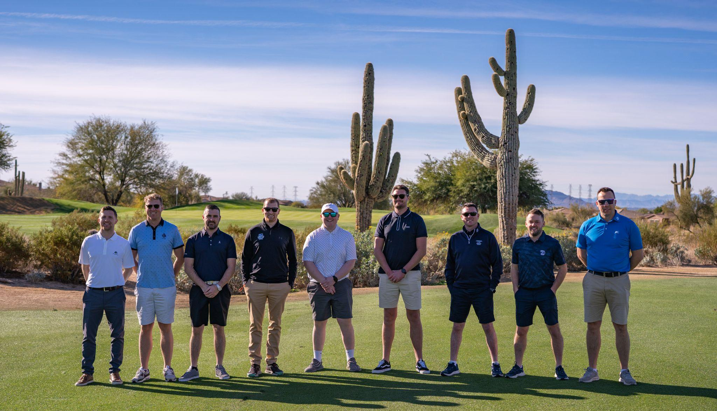
LINKS TO SUCCESS WEBINAR
Past Delegate Experience
Richard Ponsford
Course Manager, Clevedon Golf Club
Past Delegate - Phoenix 2023

Slide 10
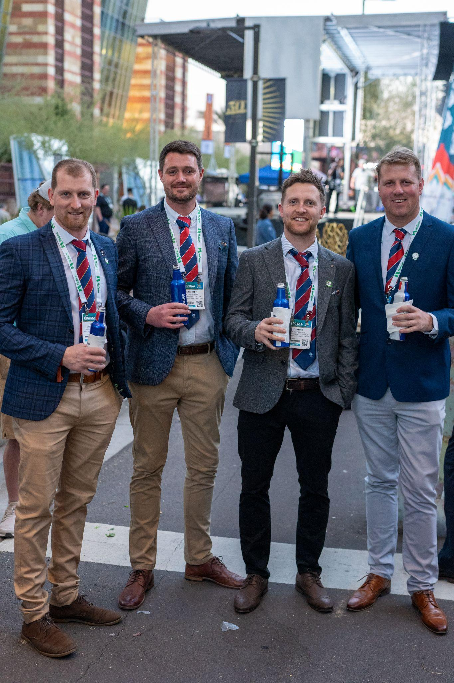
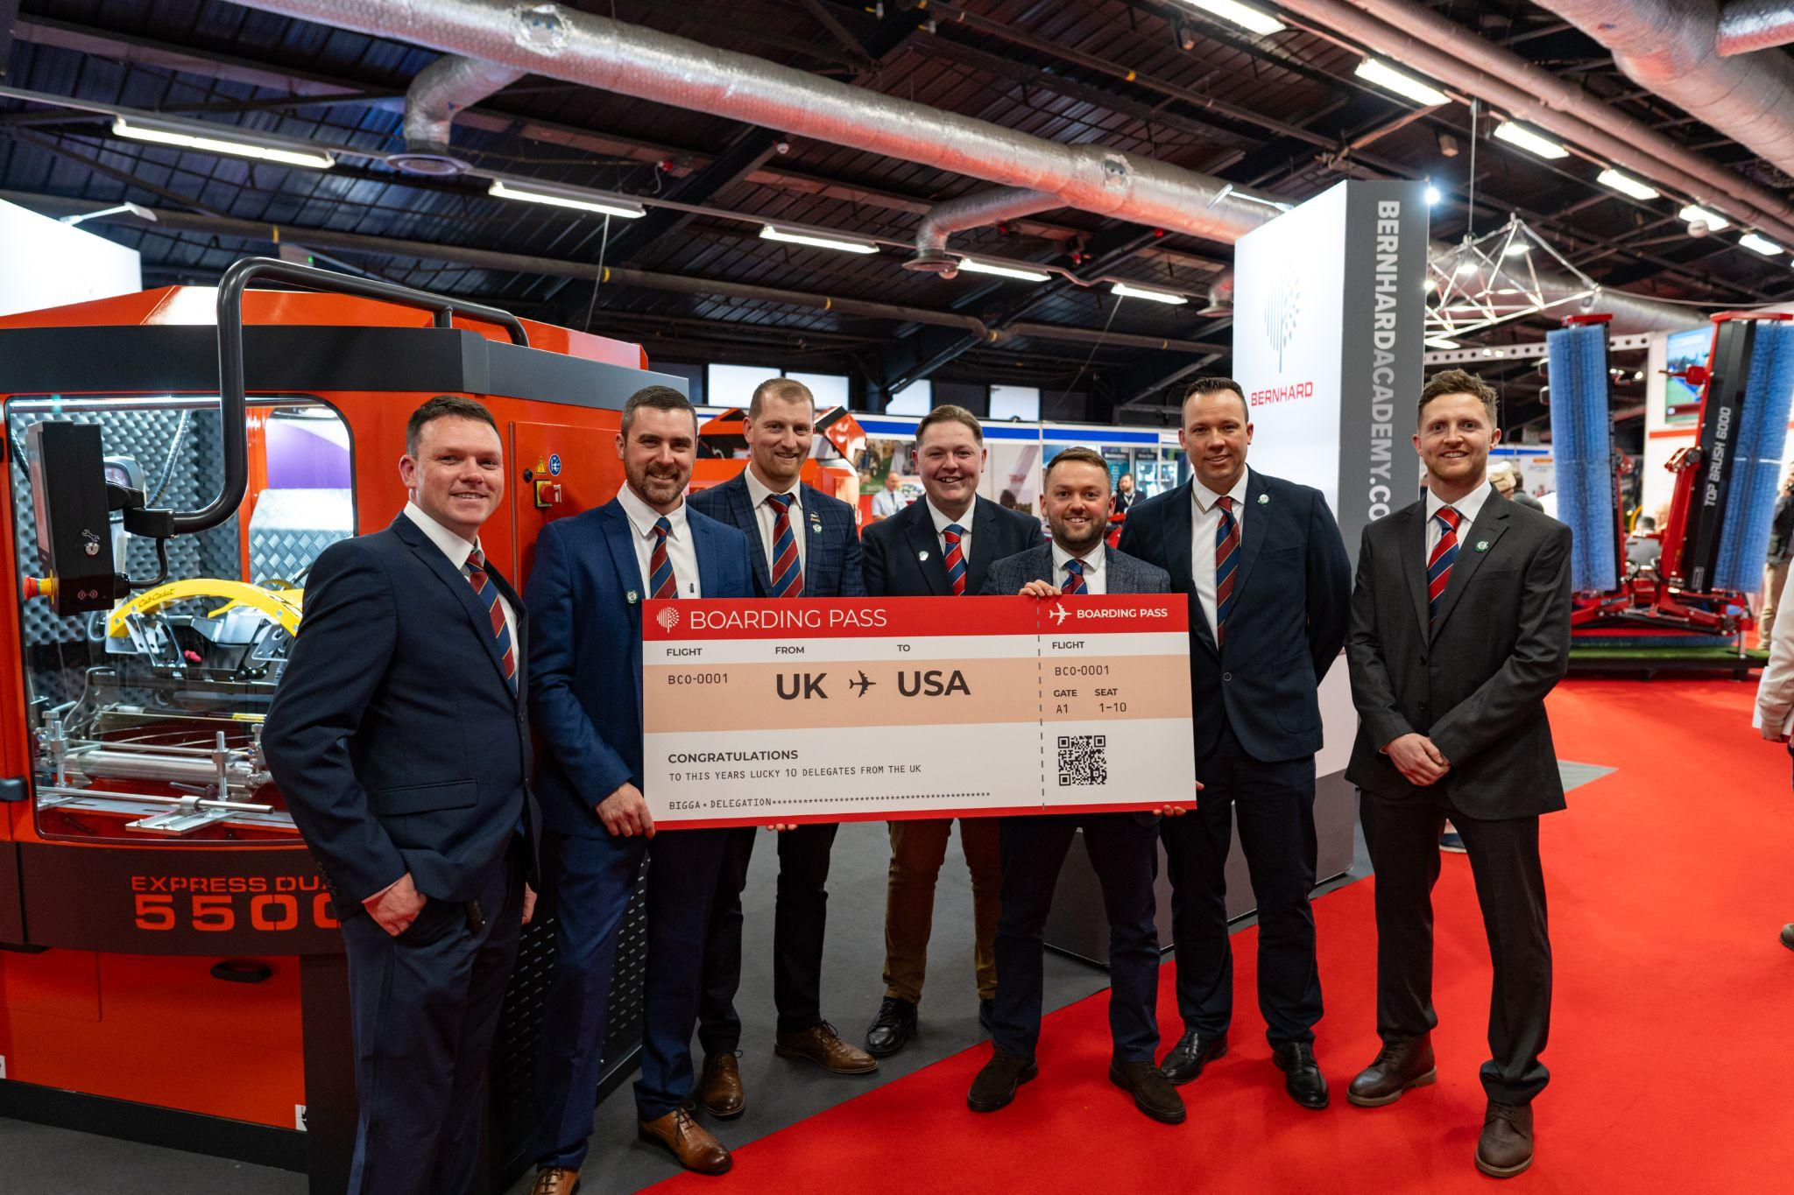
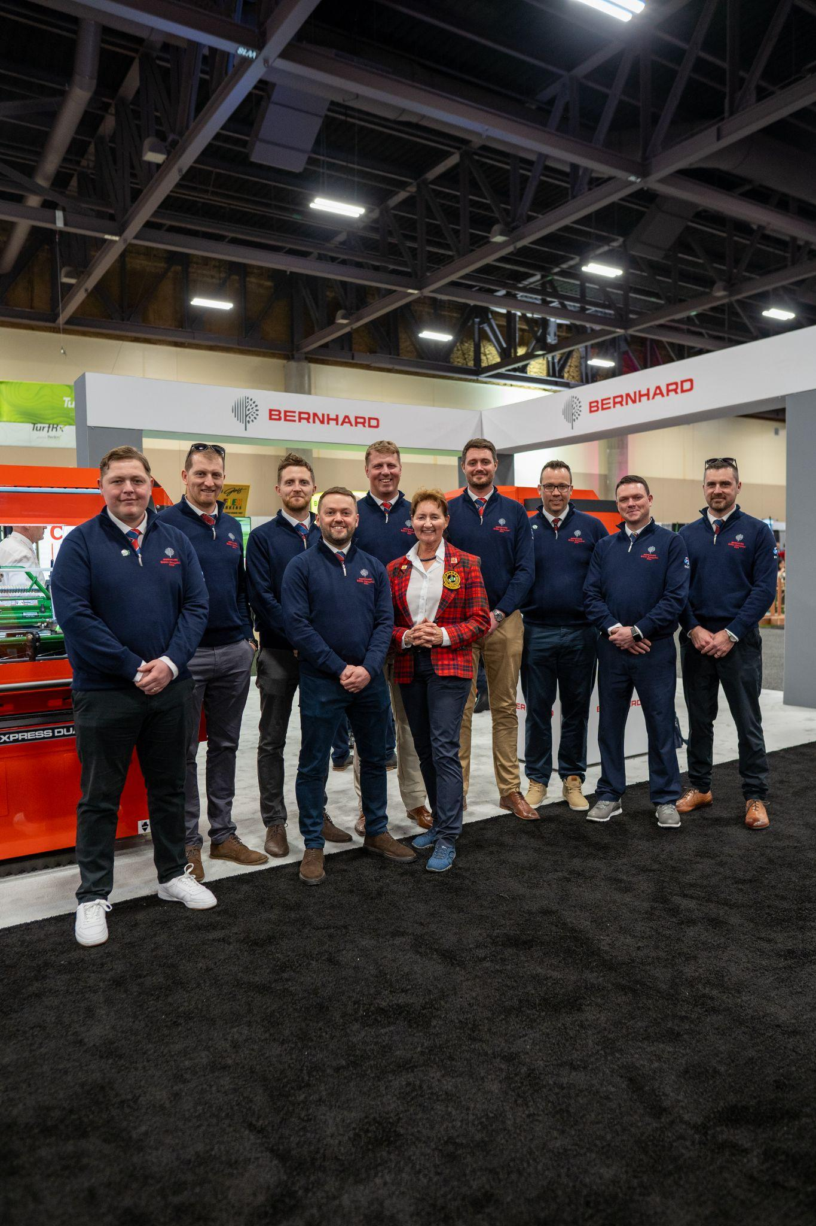
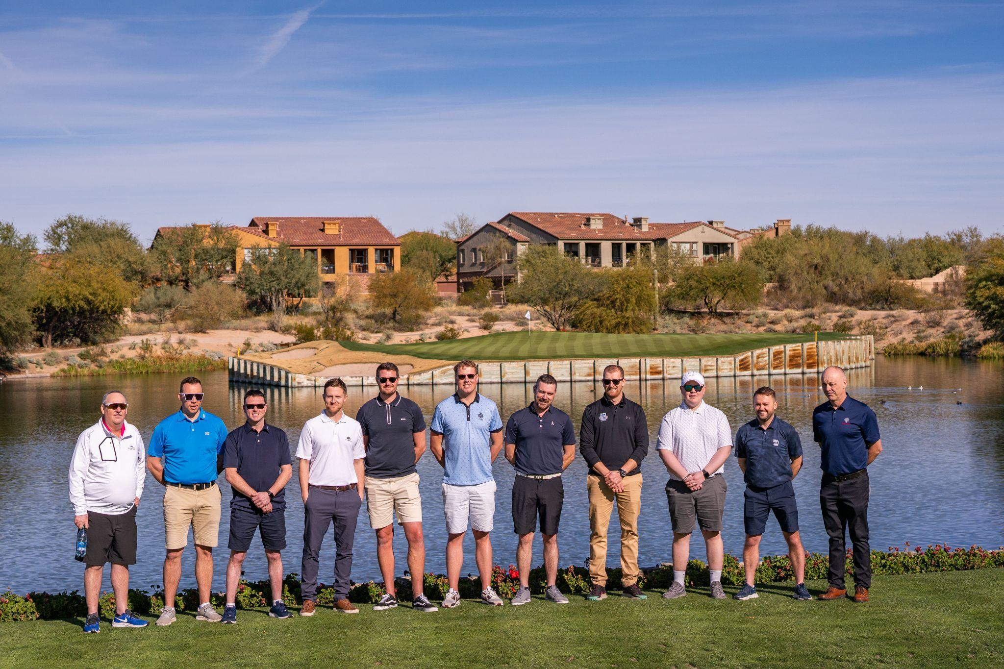
LINKS TO SUCCESS WEBINAR
Past Delegate Experience

Slide 11
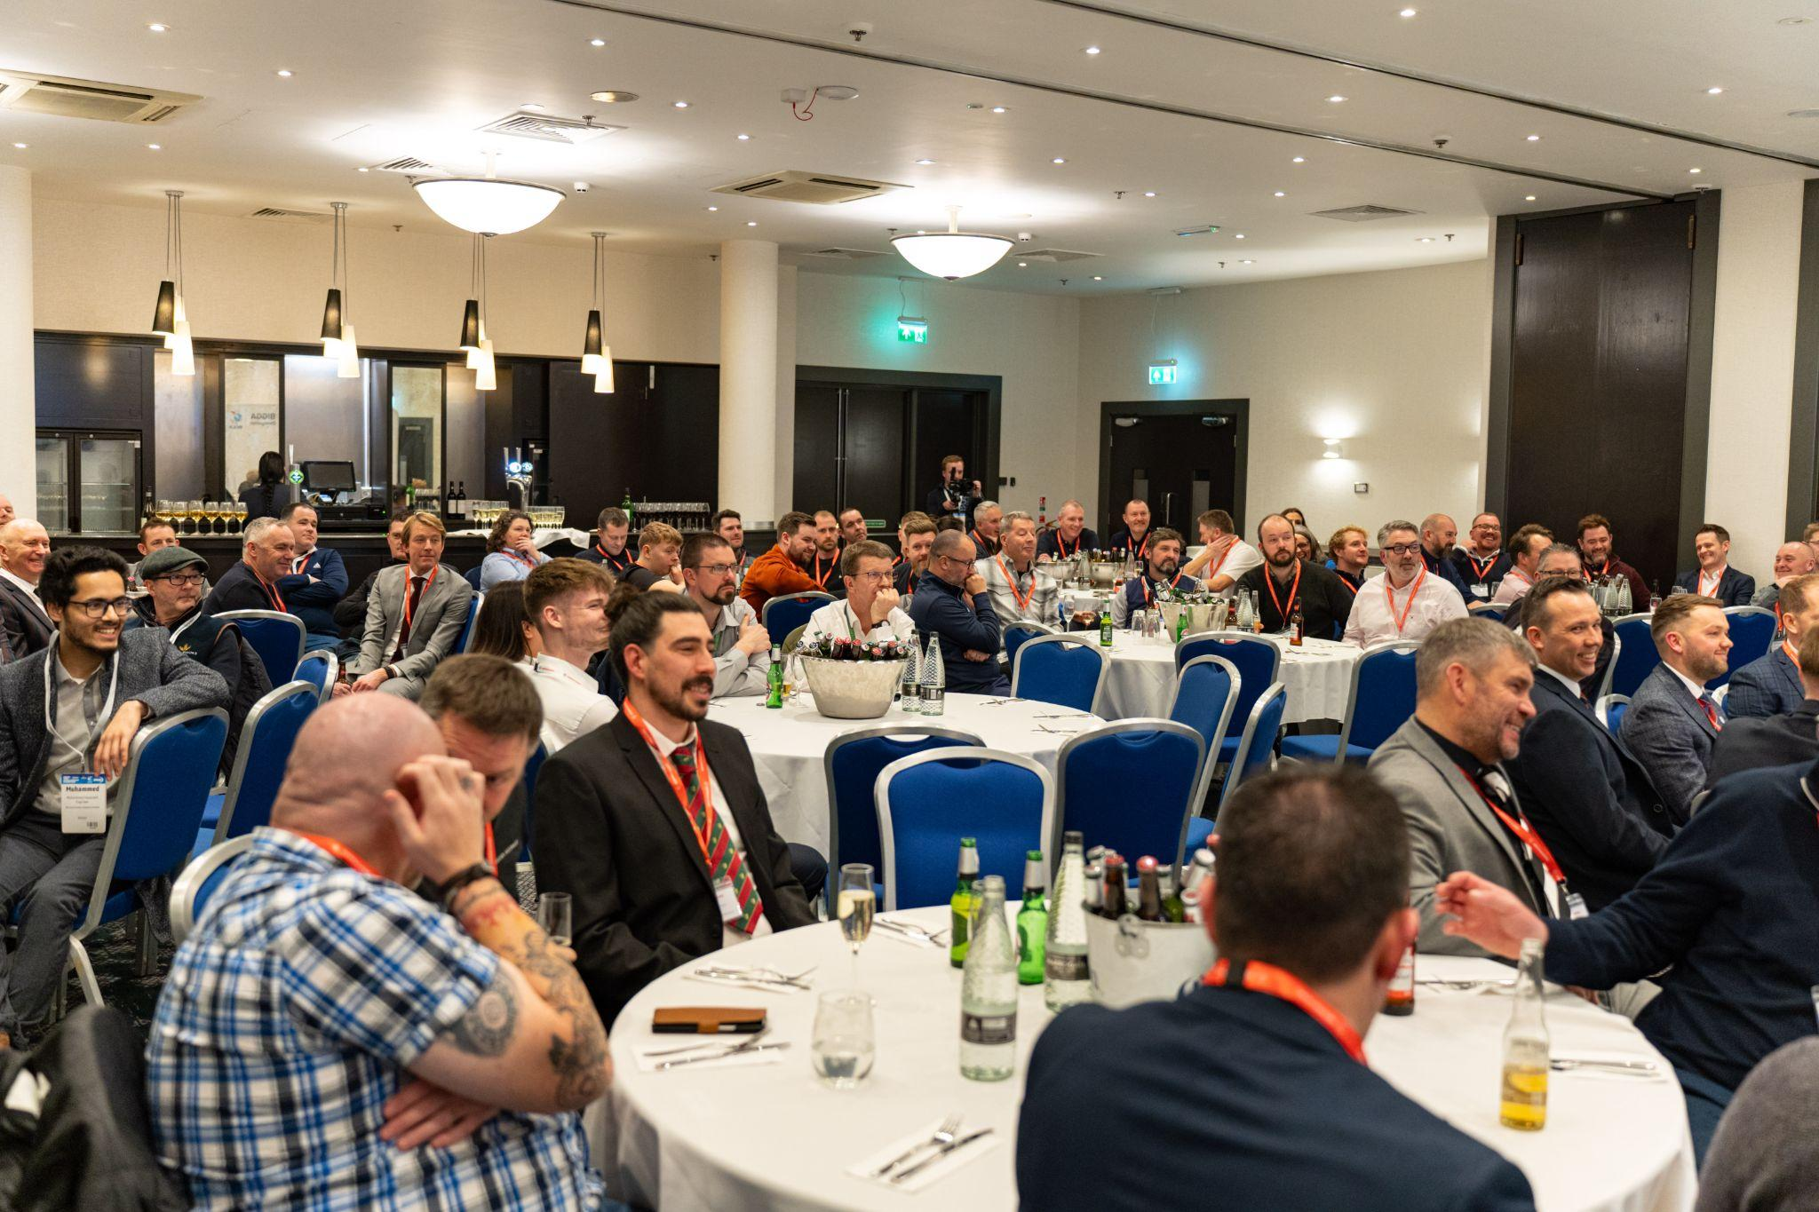
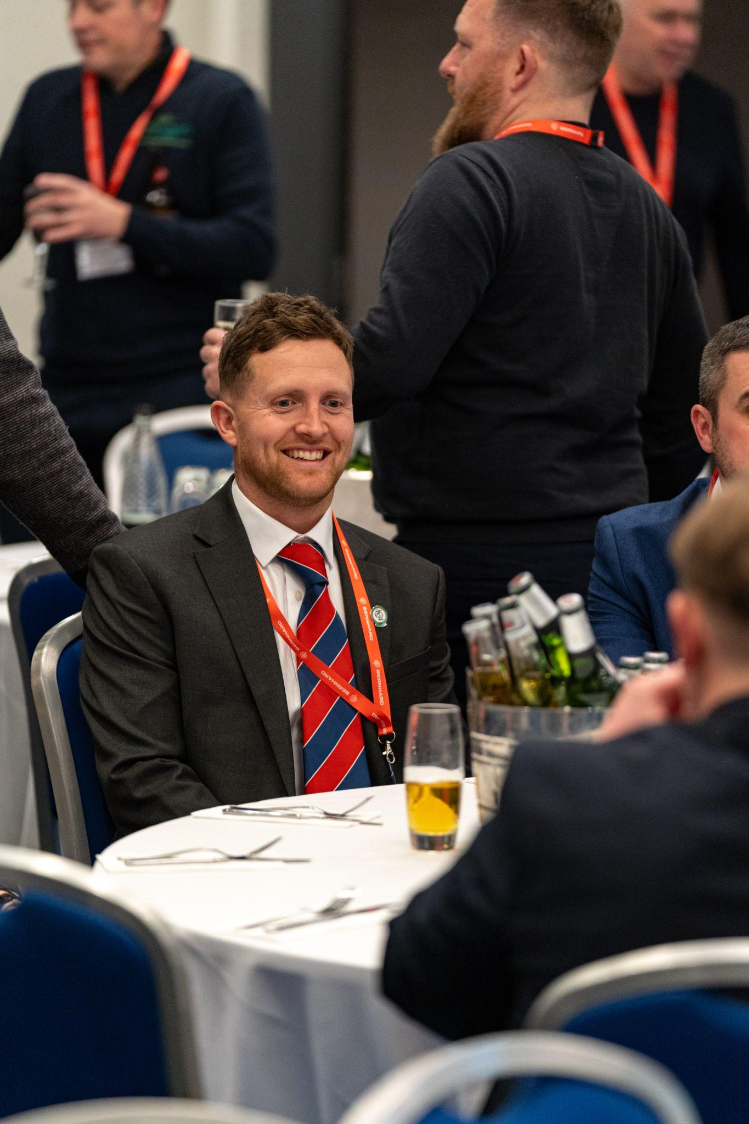
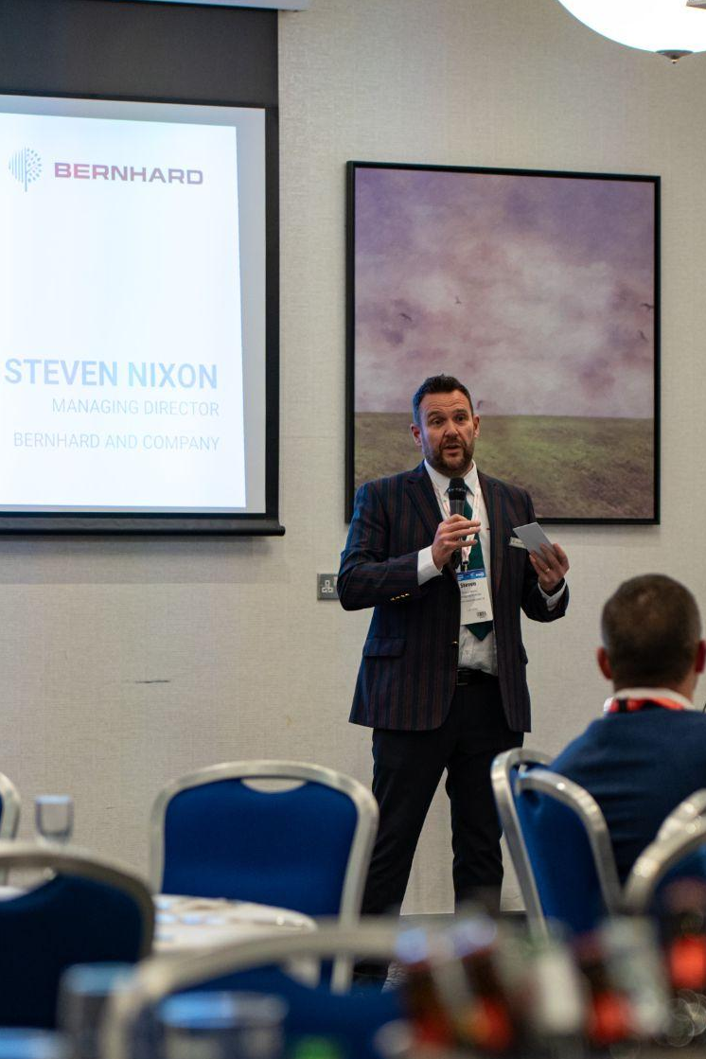
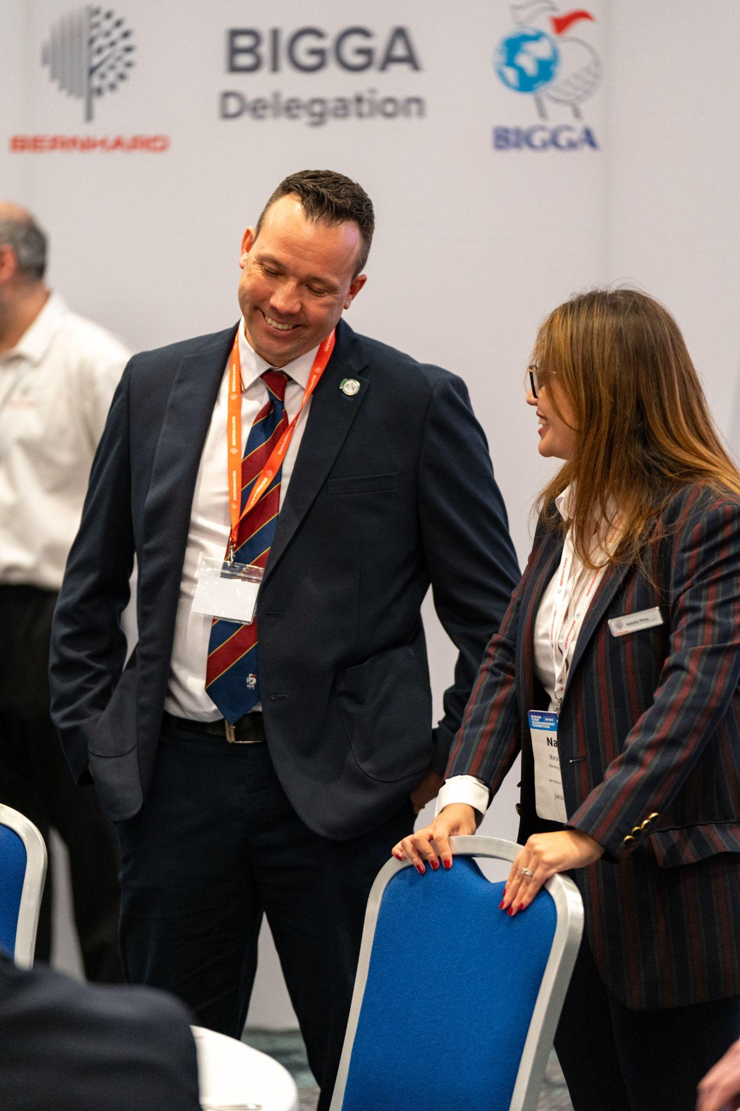
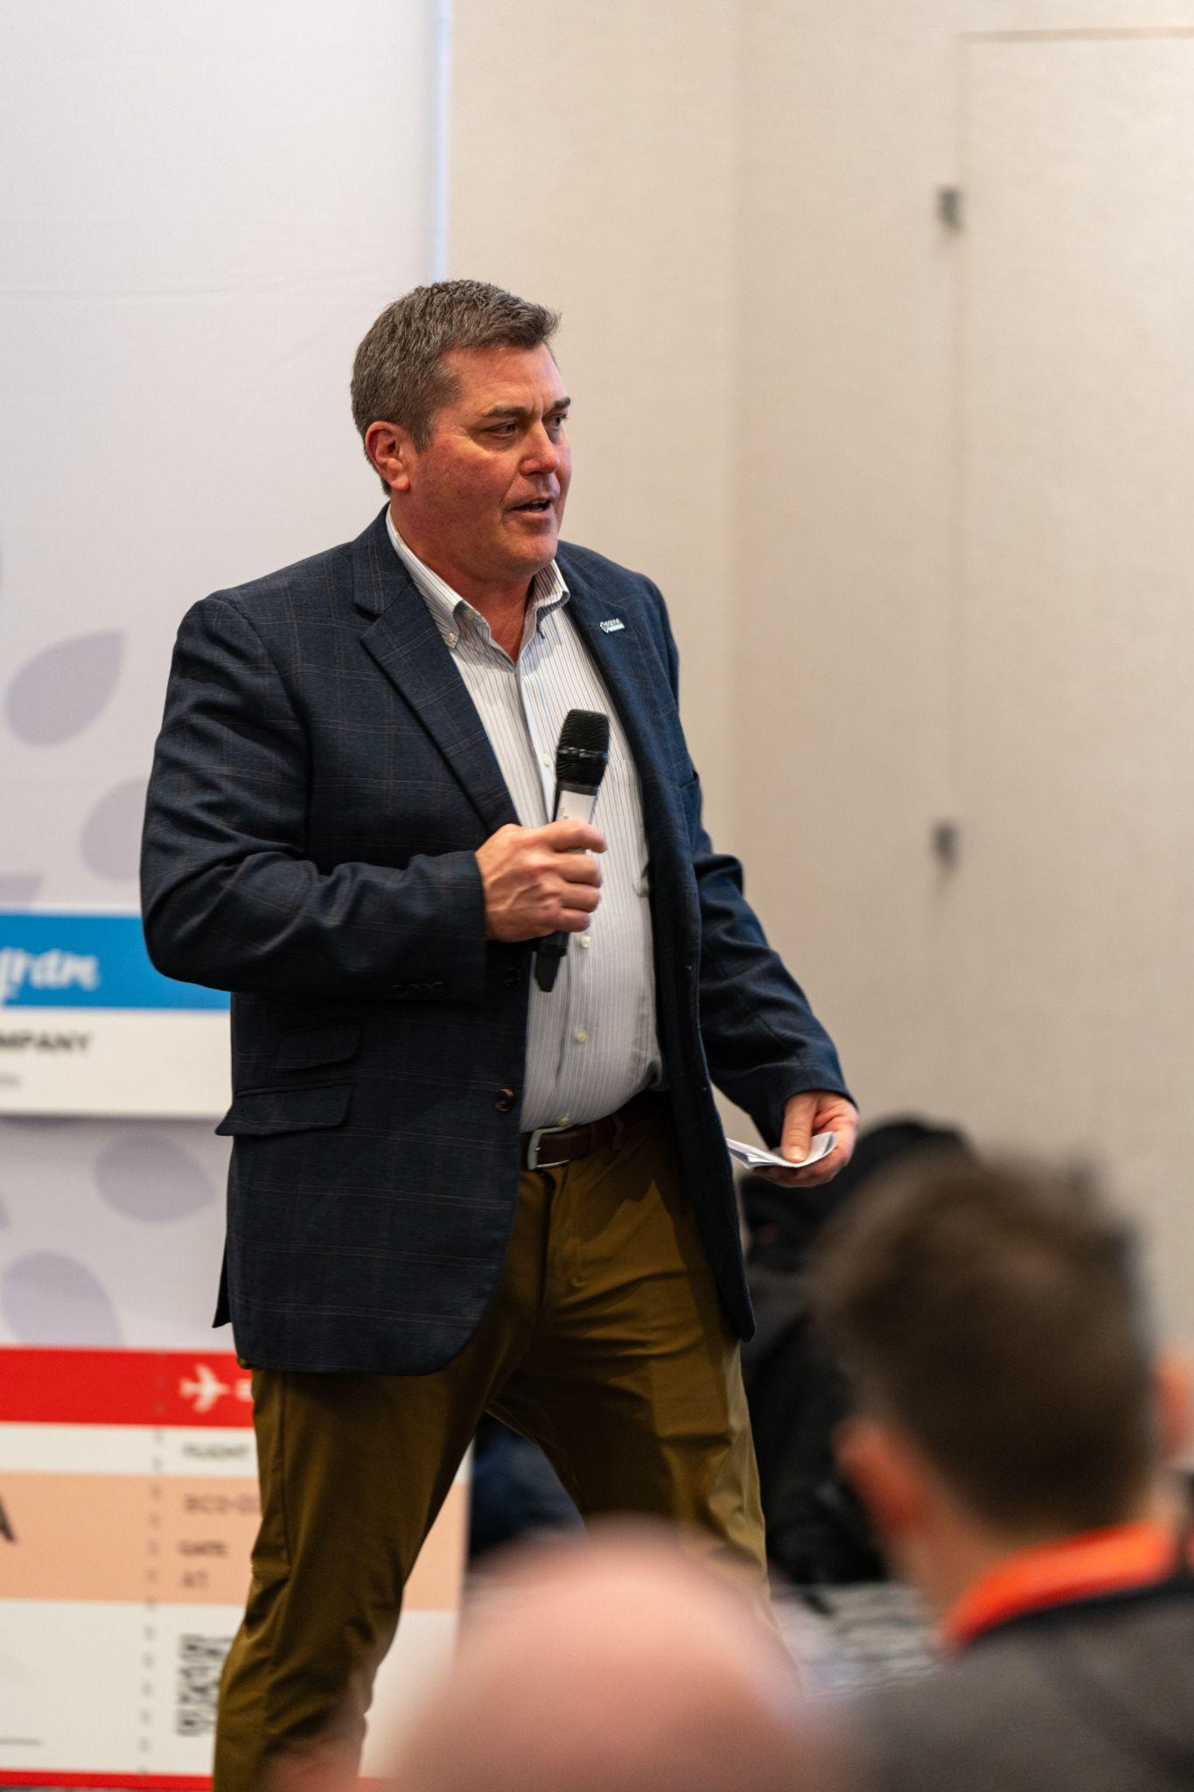
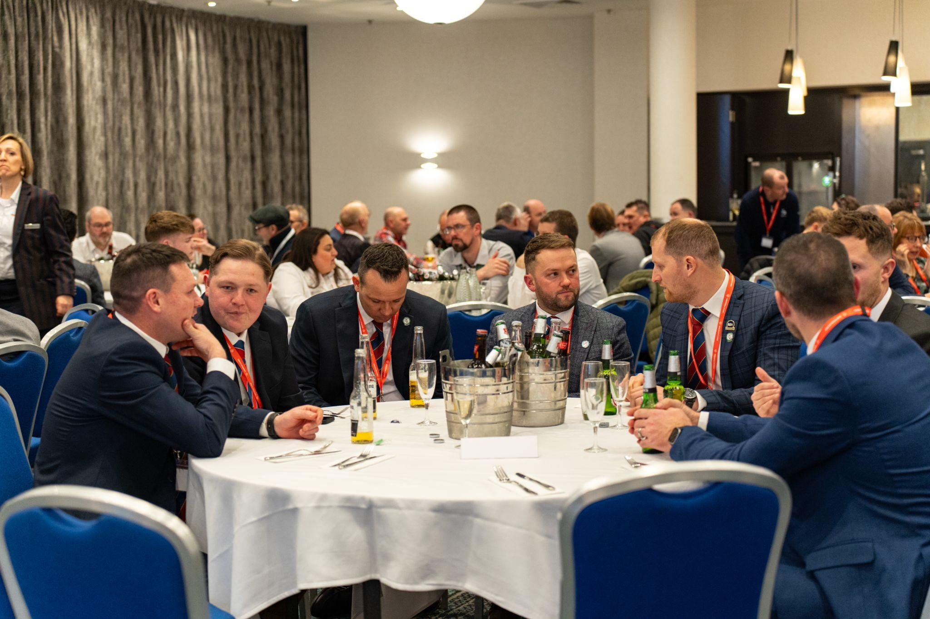
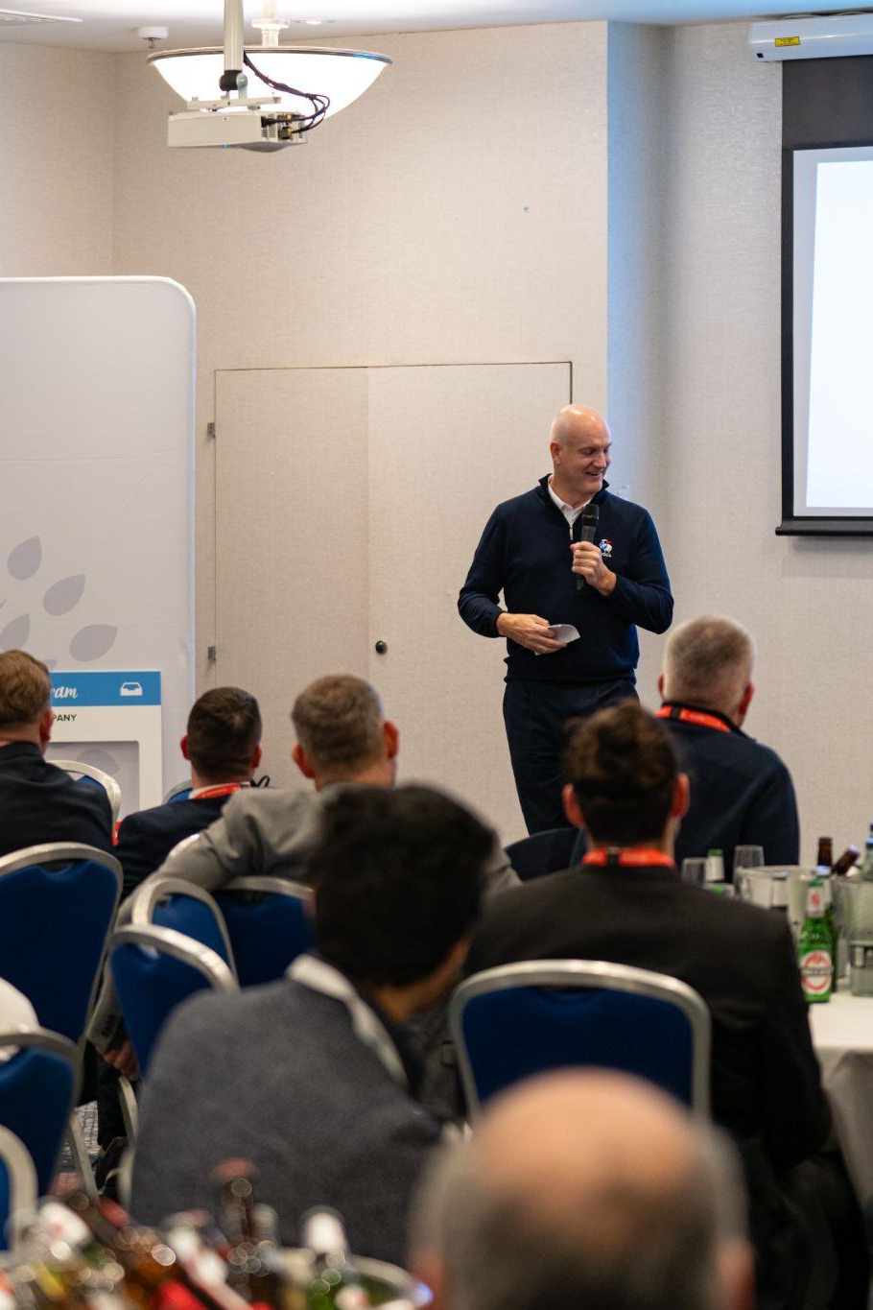
LINKS TO SUCCESS WEBINAR
Past Delegate Experience

Slide 12
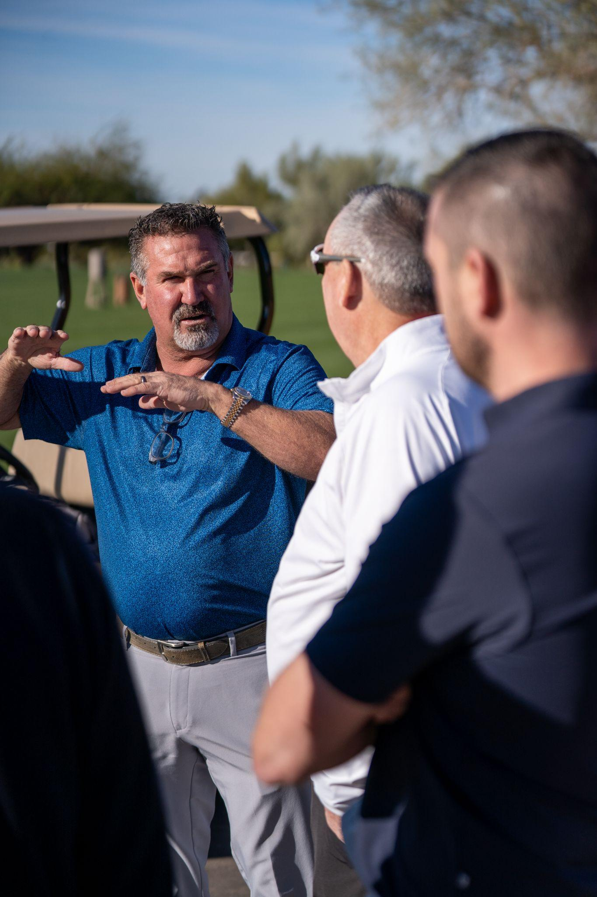
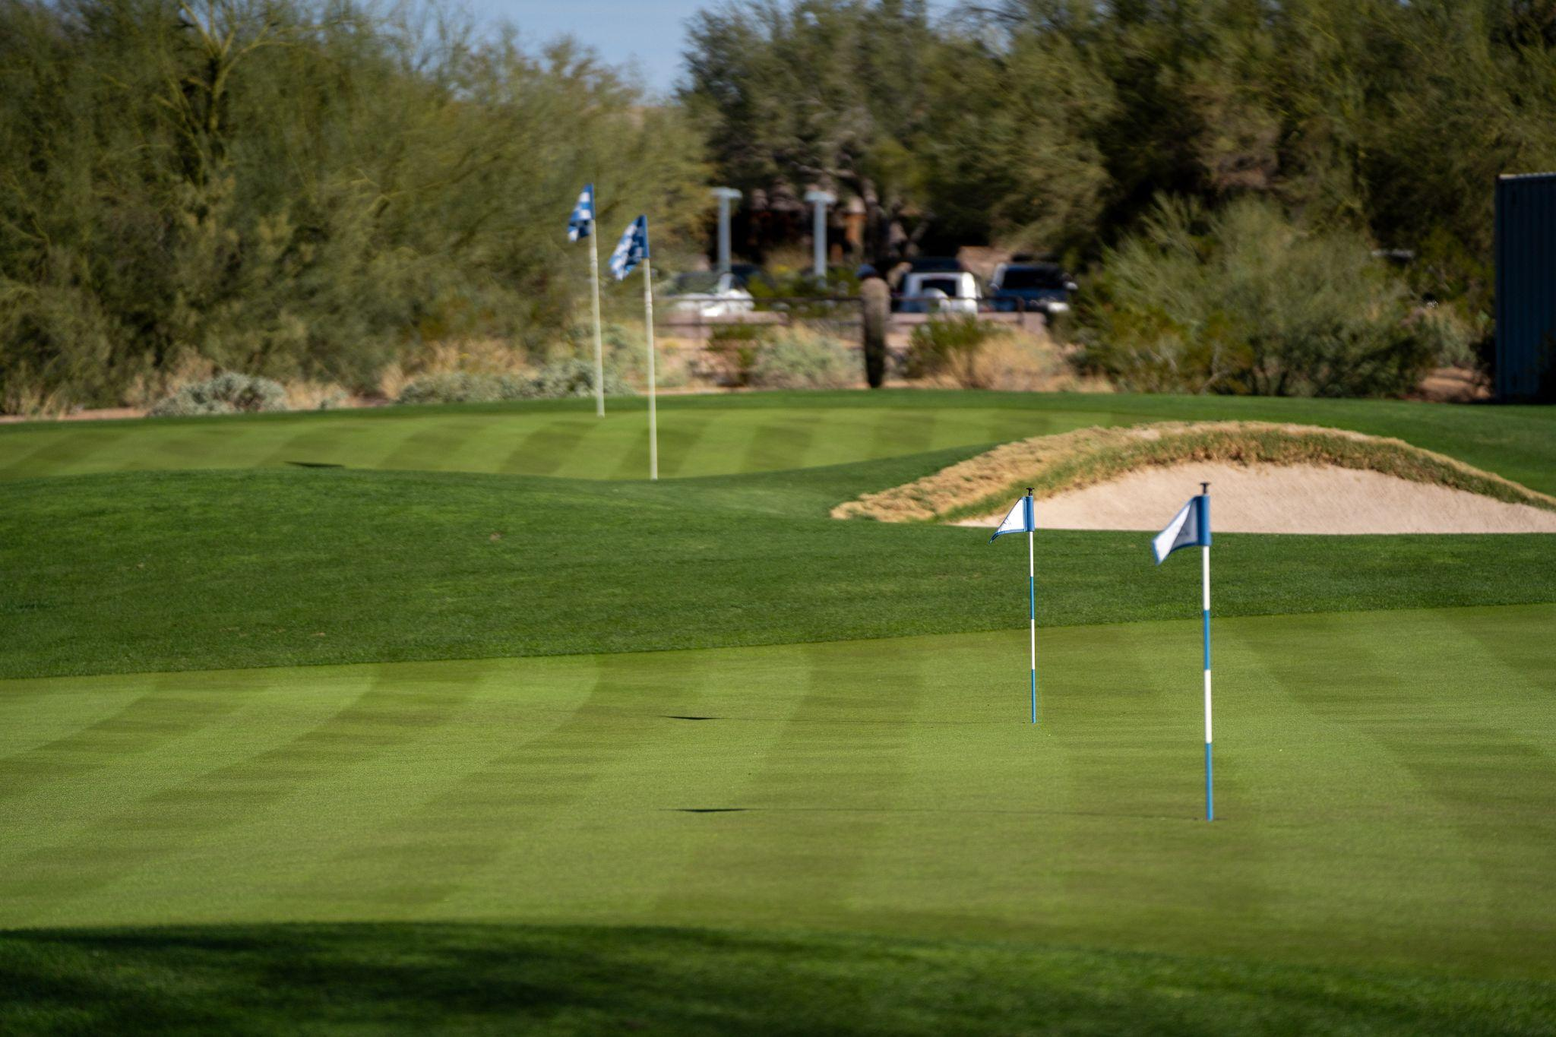
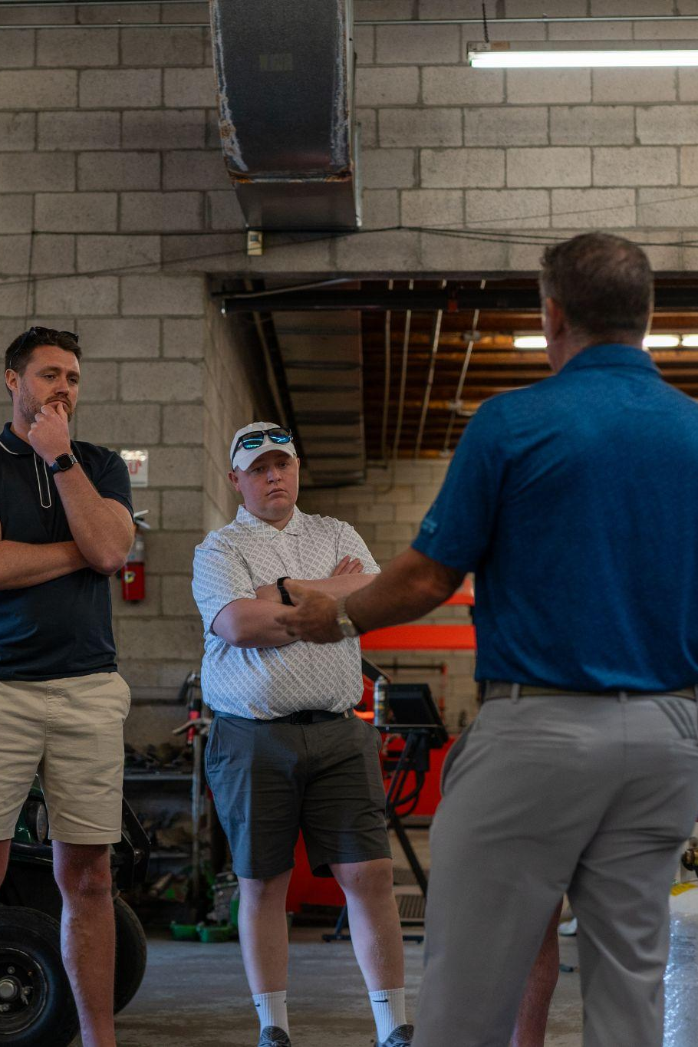
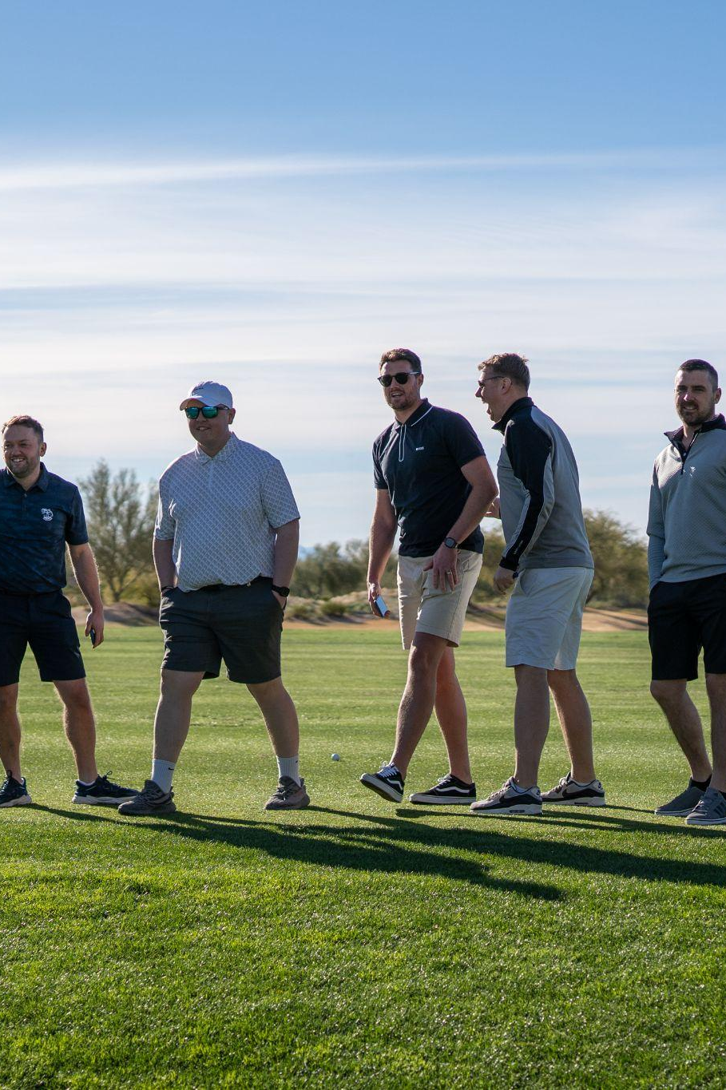

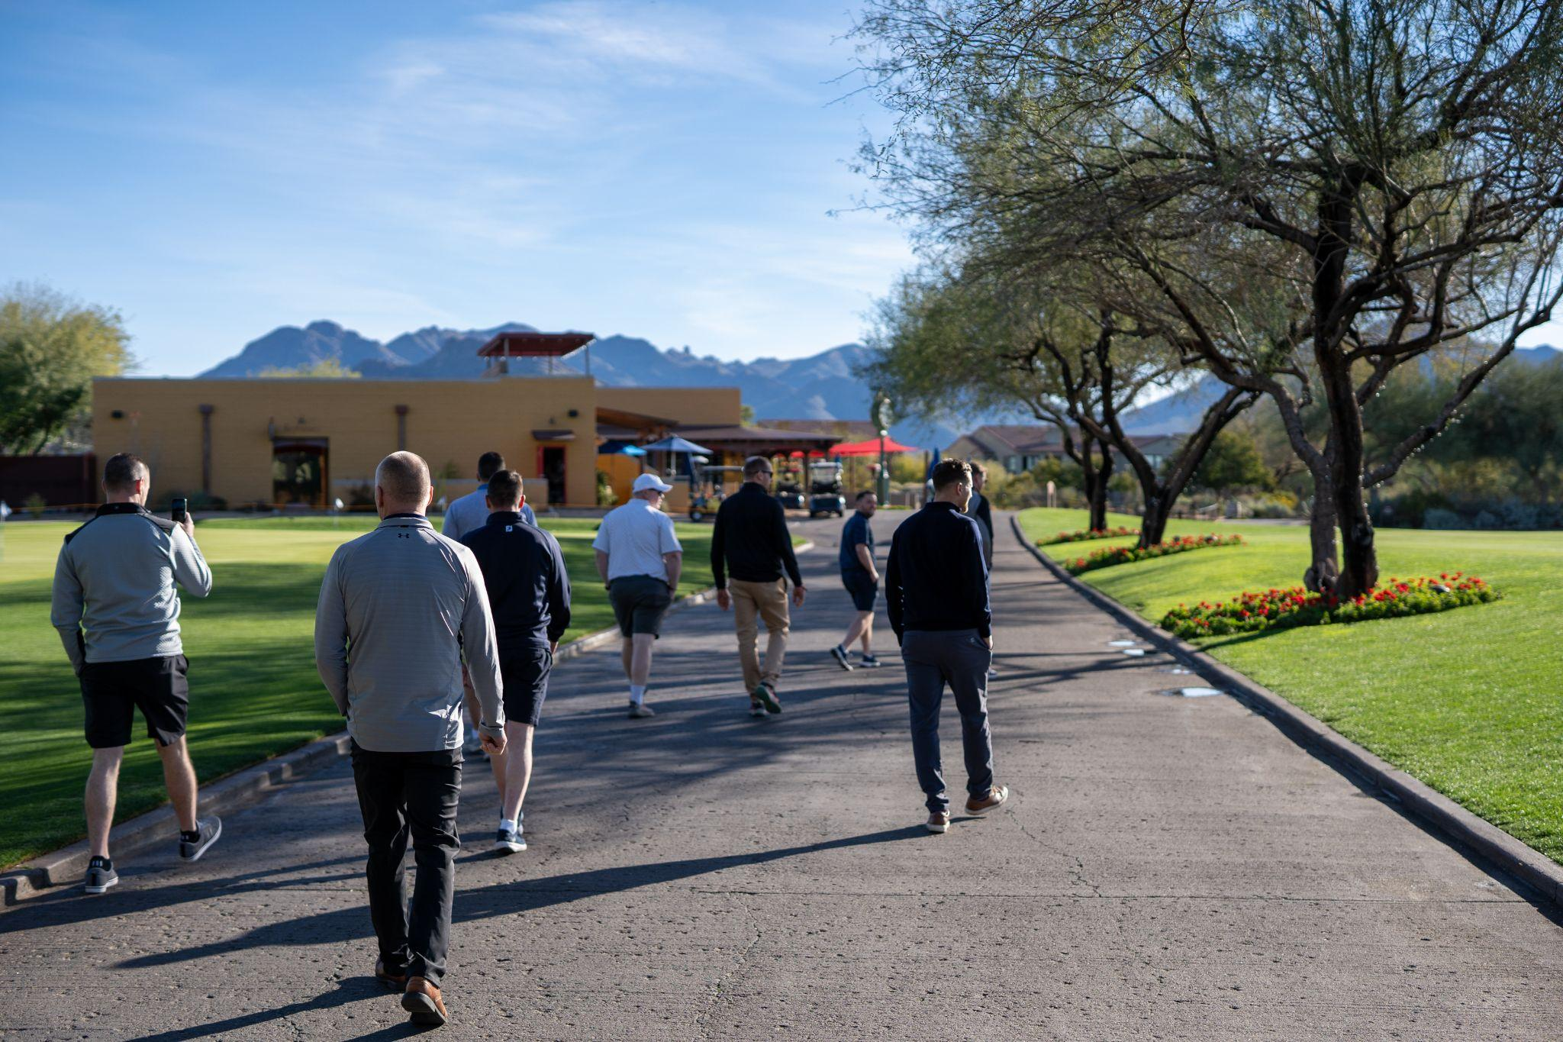
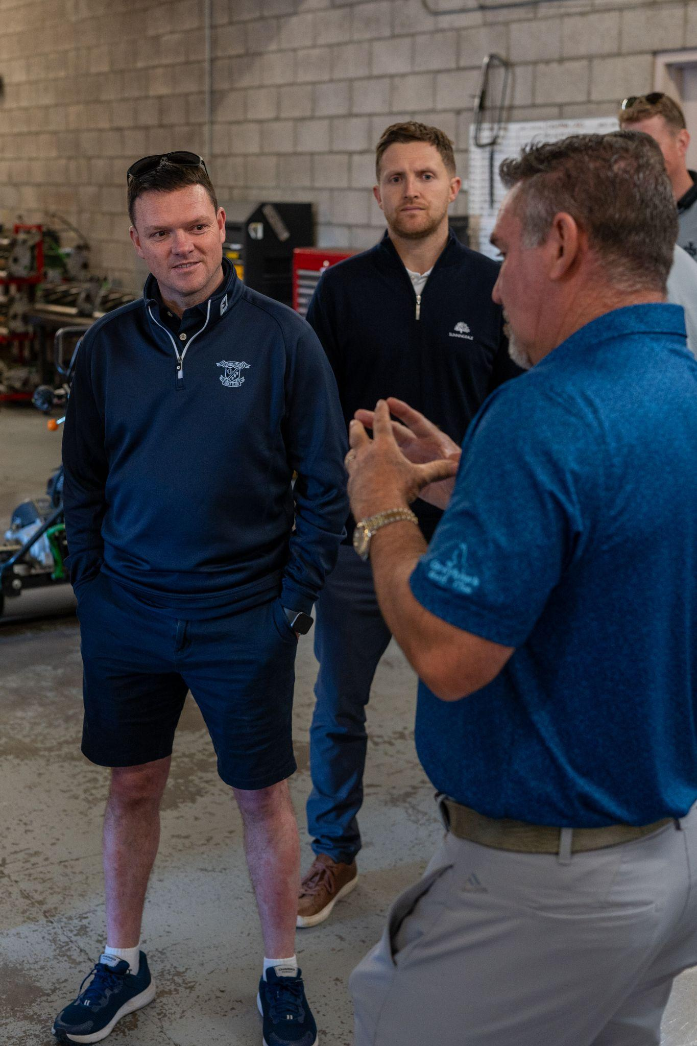
LINKS TO SUCCESS WEBINAR
Past Delegate Experience

Slide 13
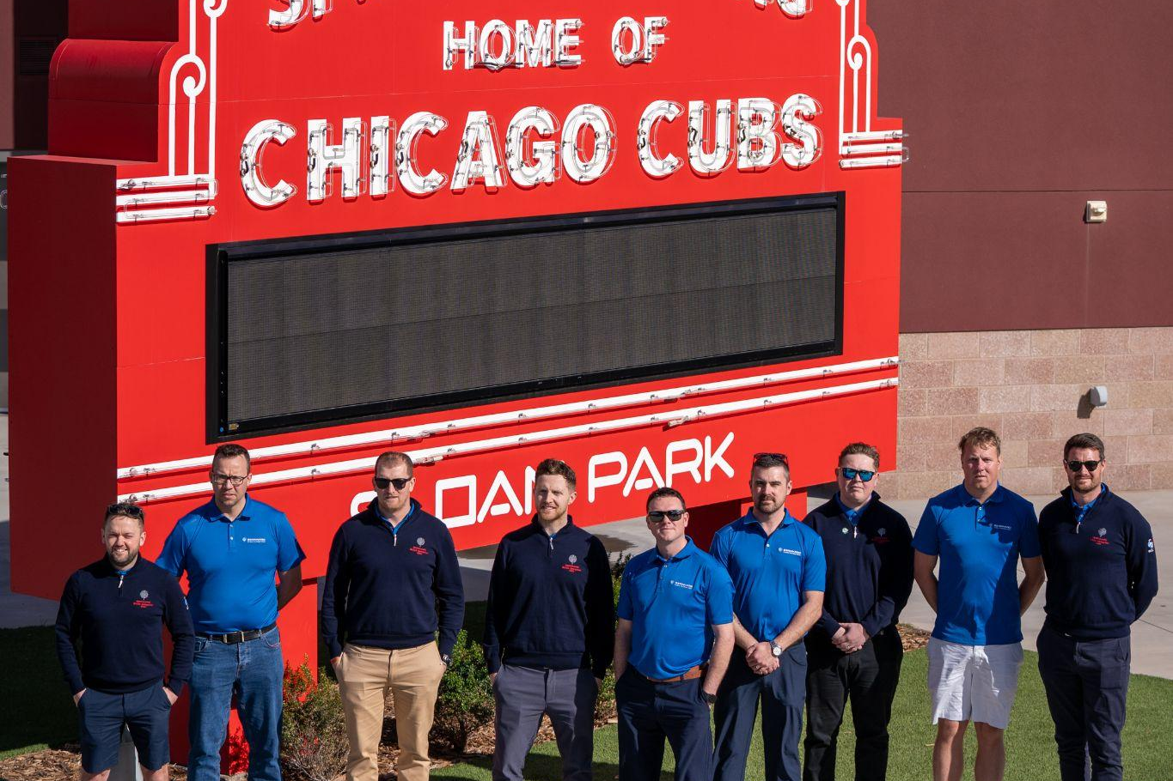
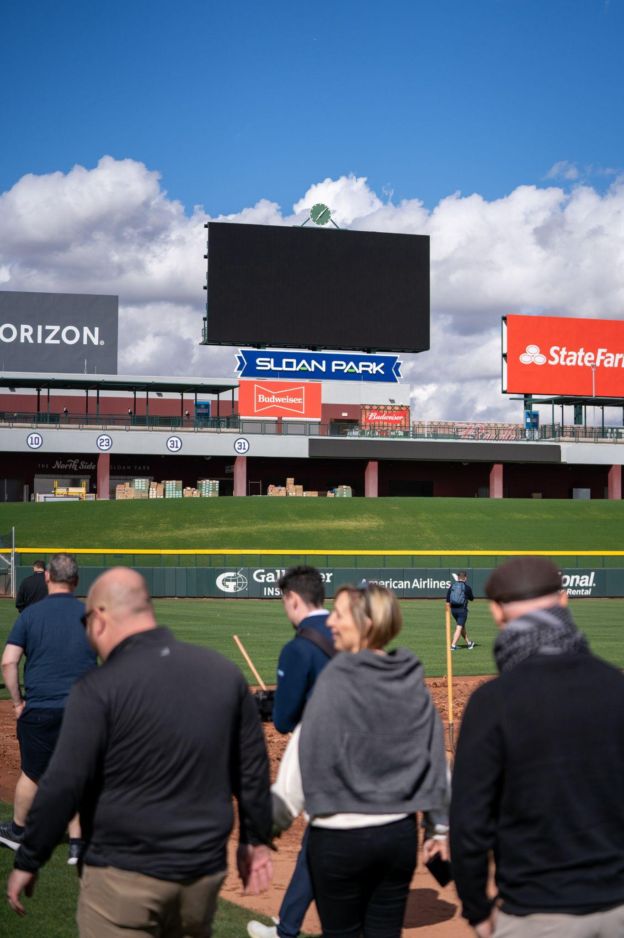
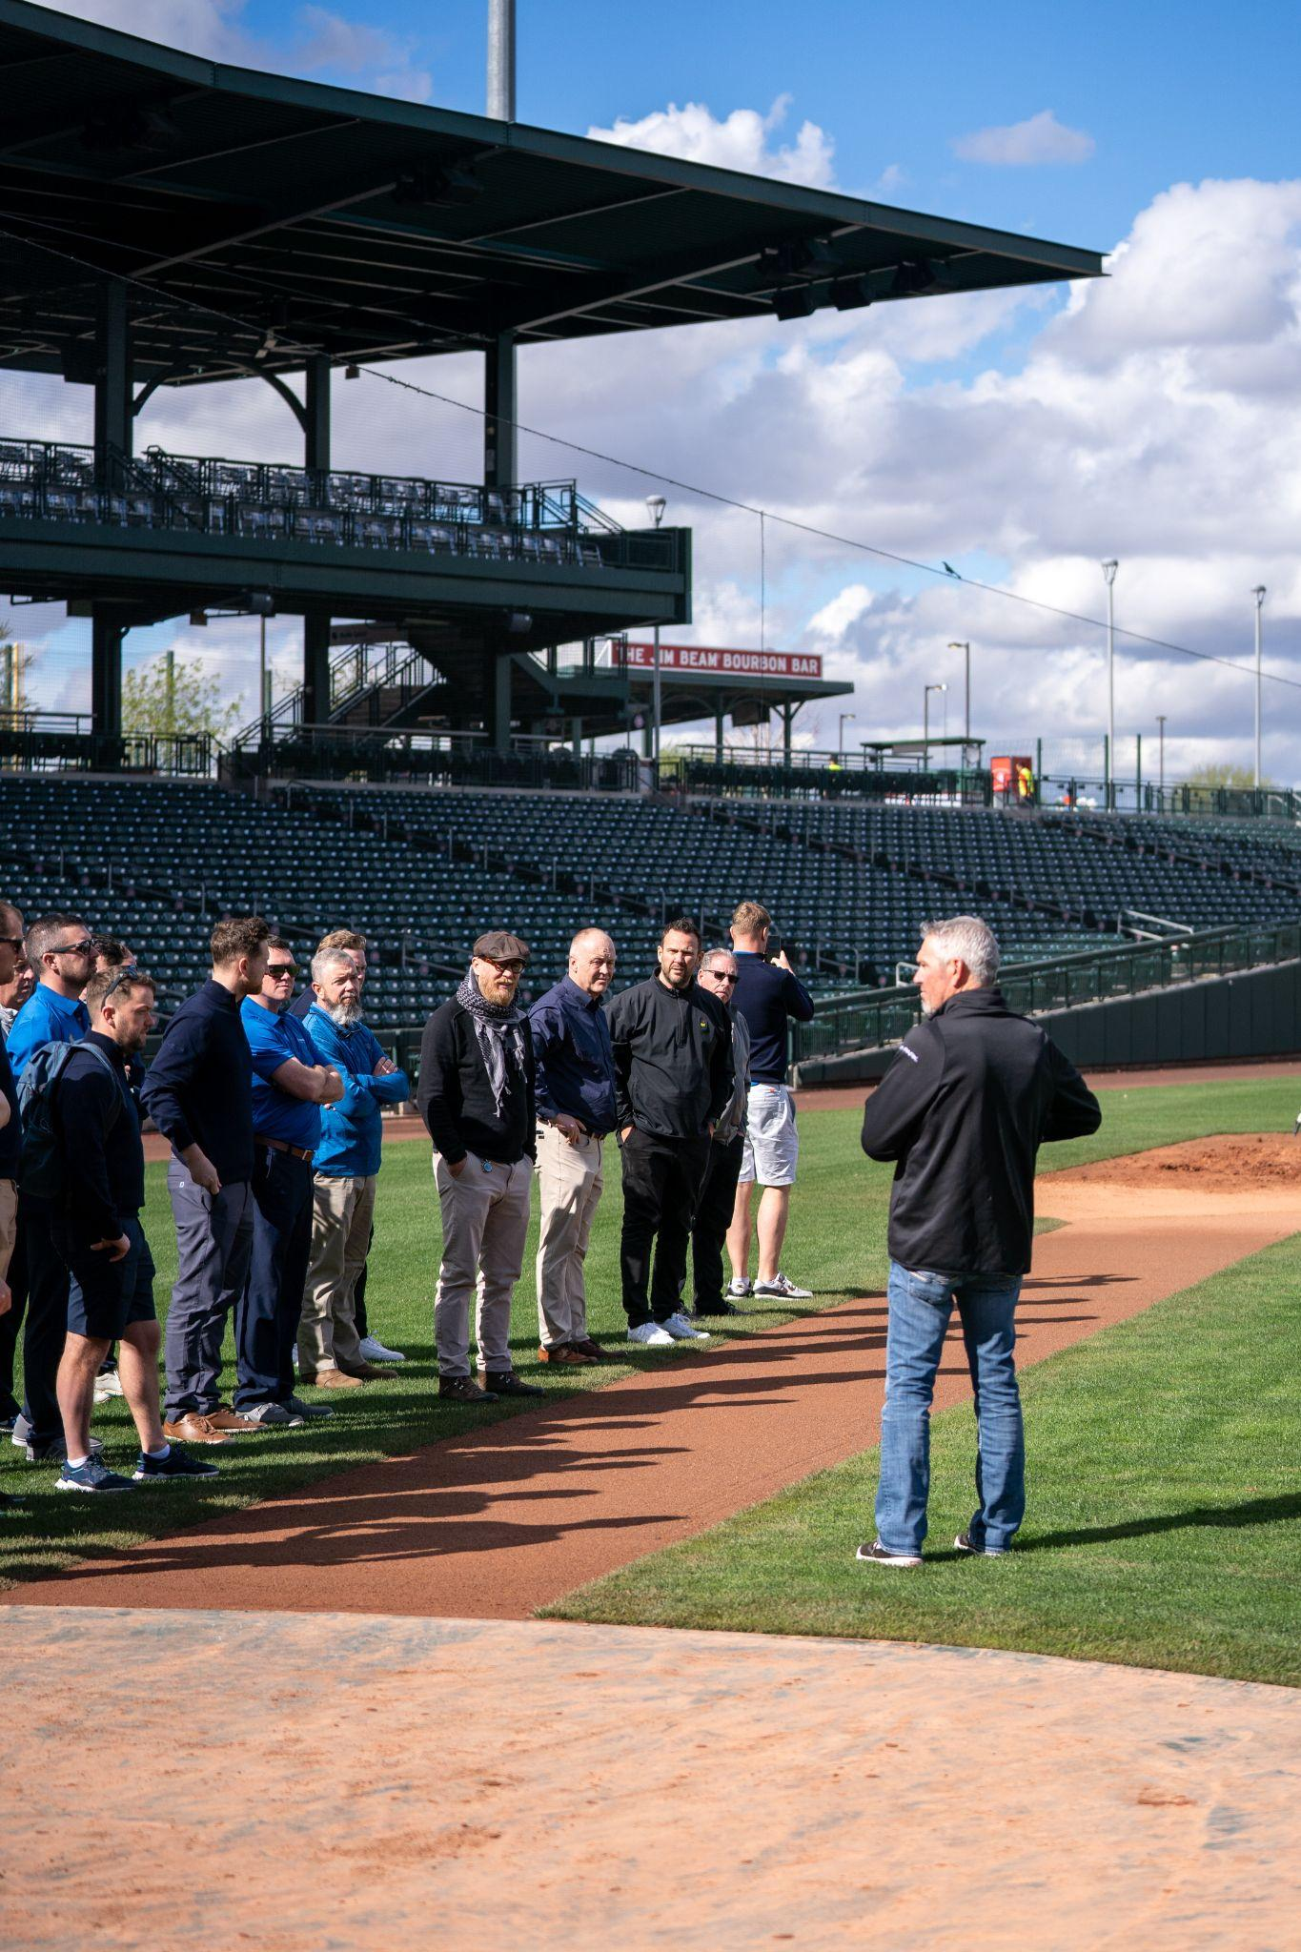
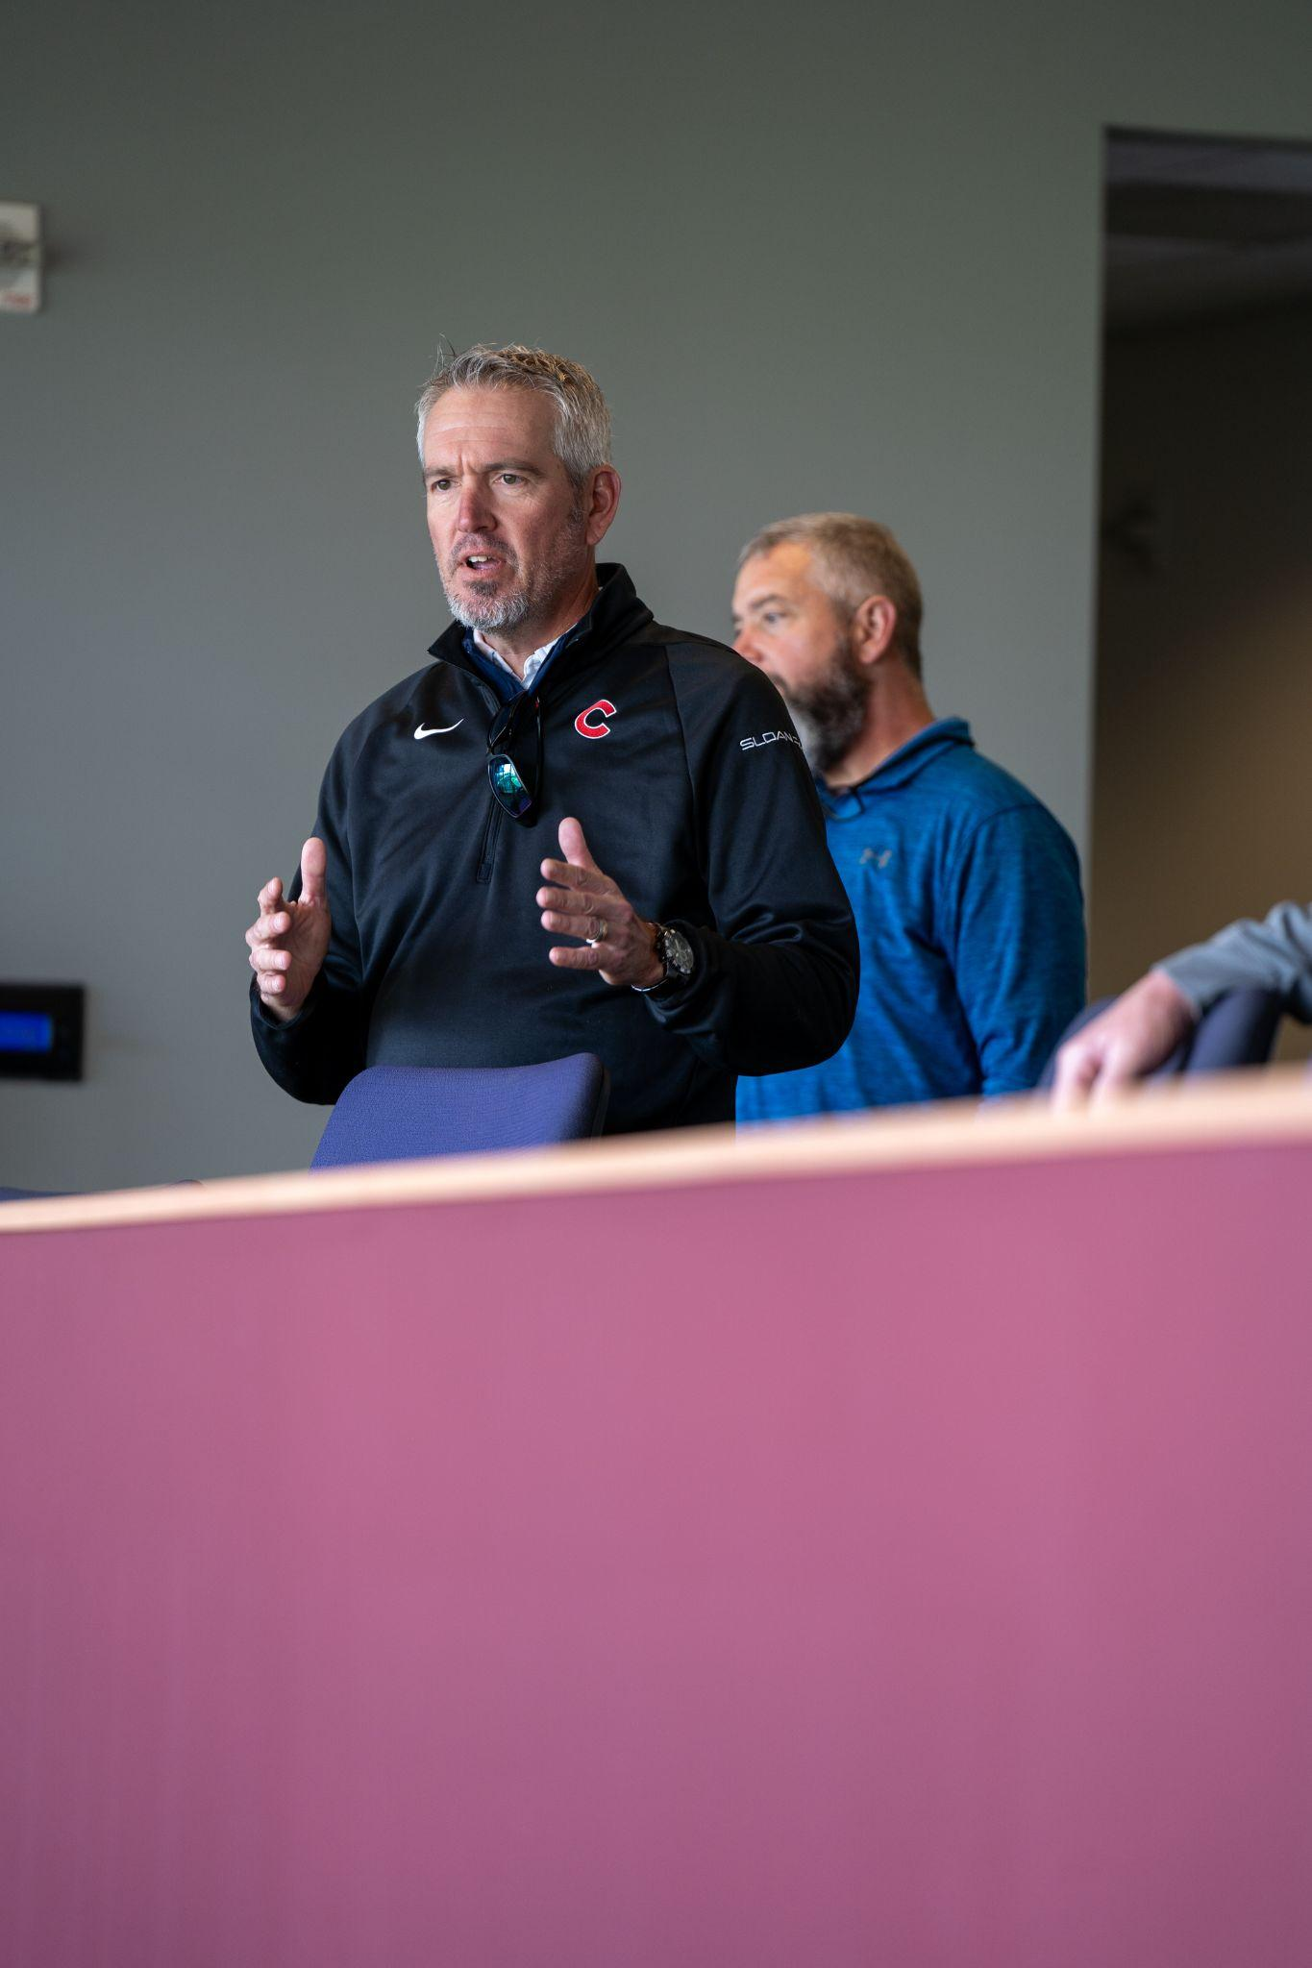
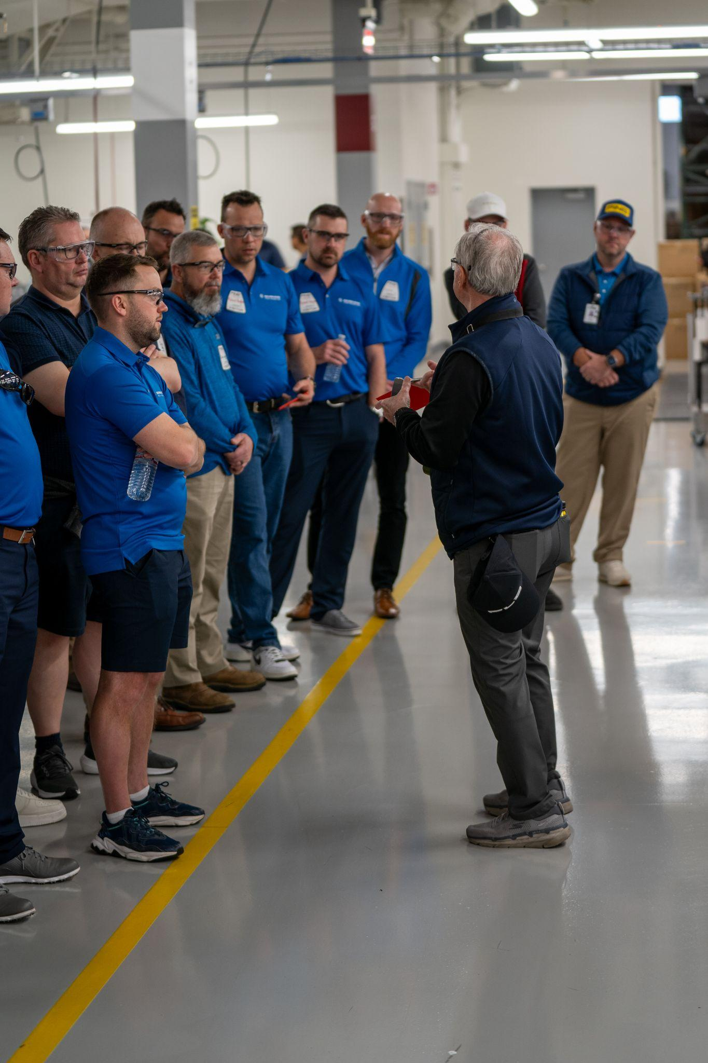
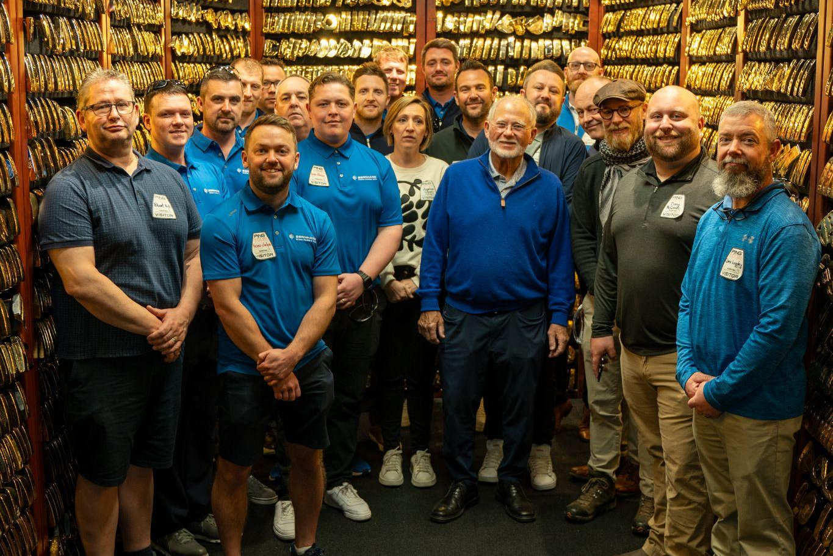
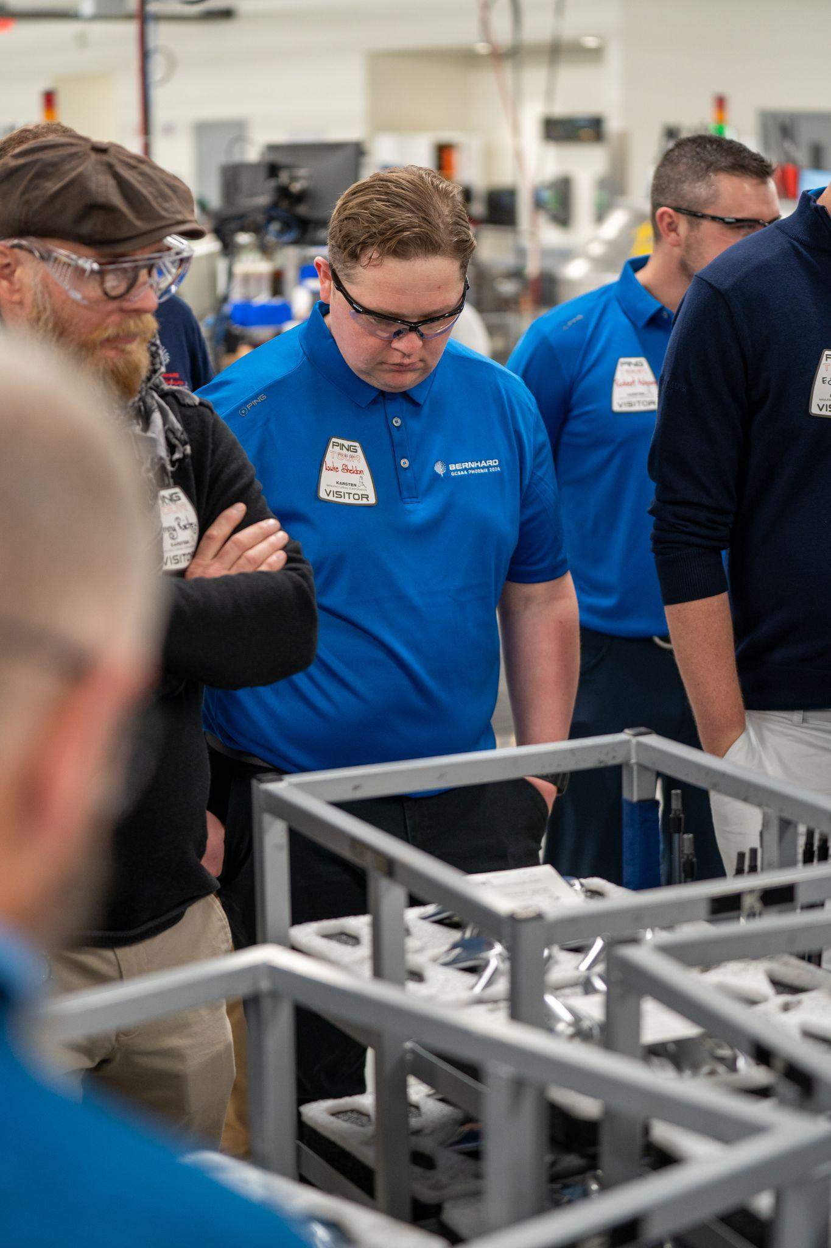
LINKS TO SUCCESS WEBINAR
Past Delegate Experience

Slide 14
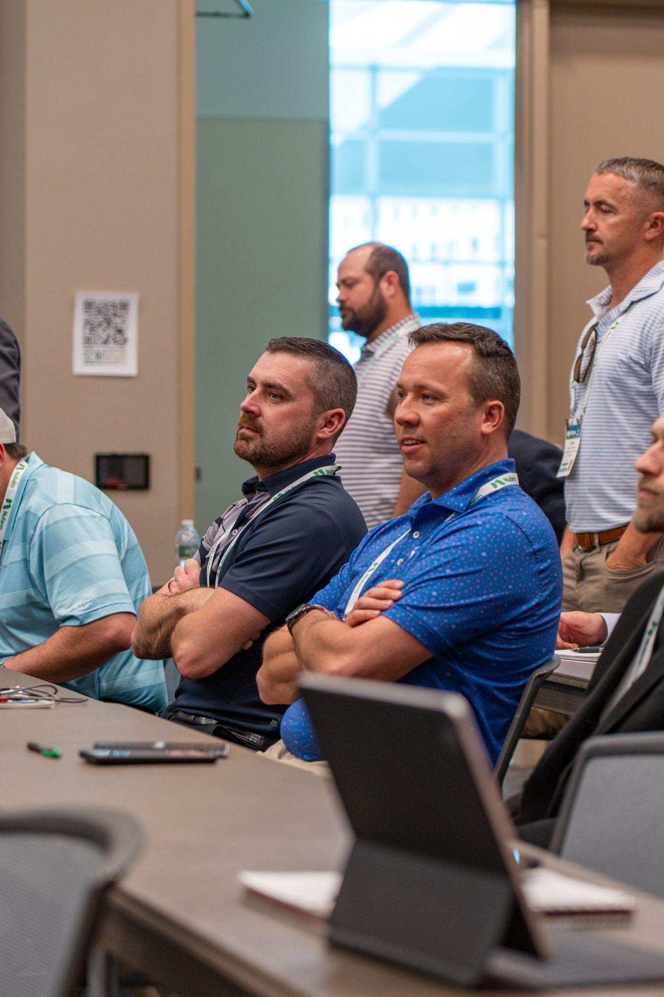
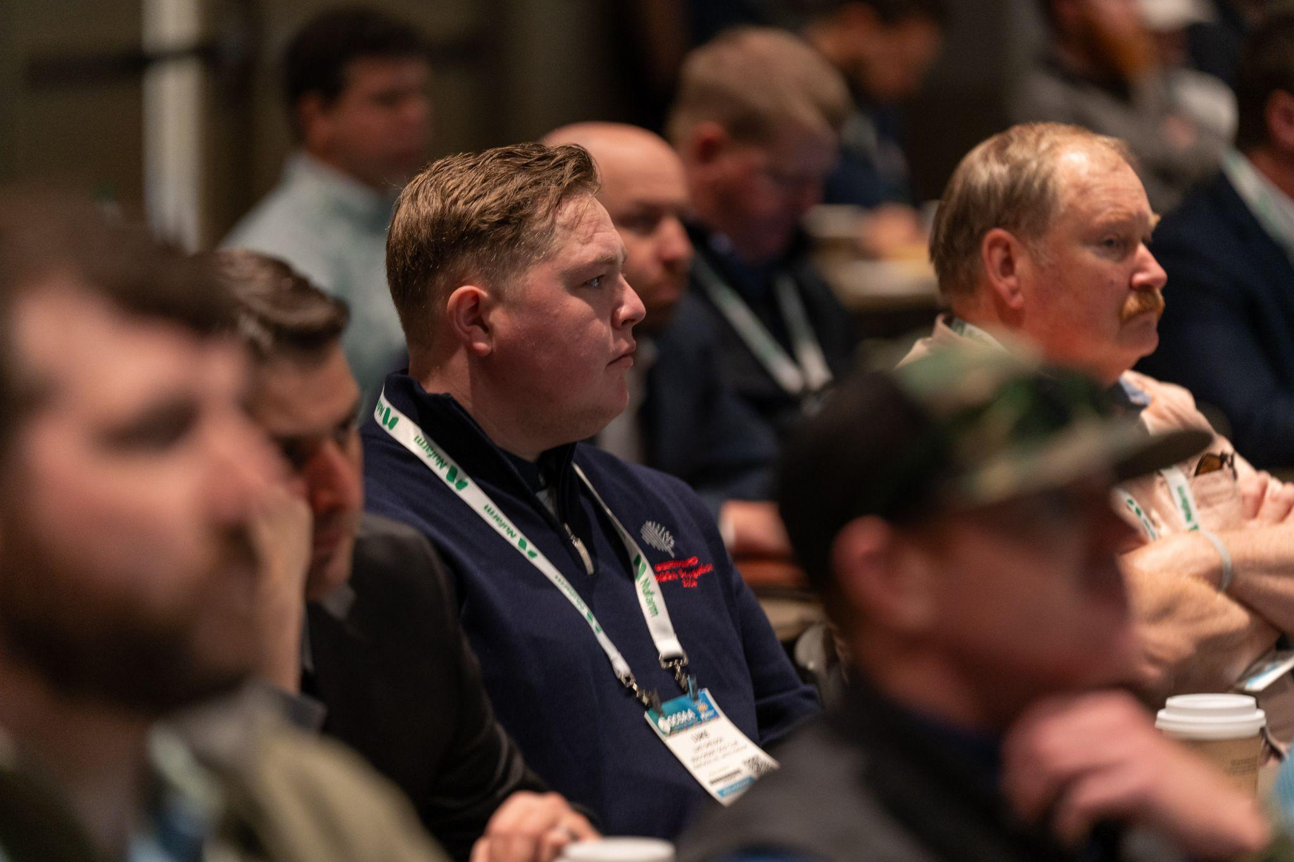
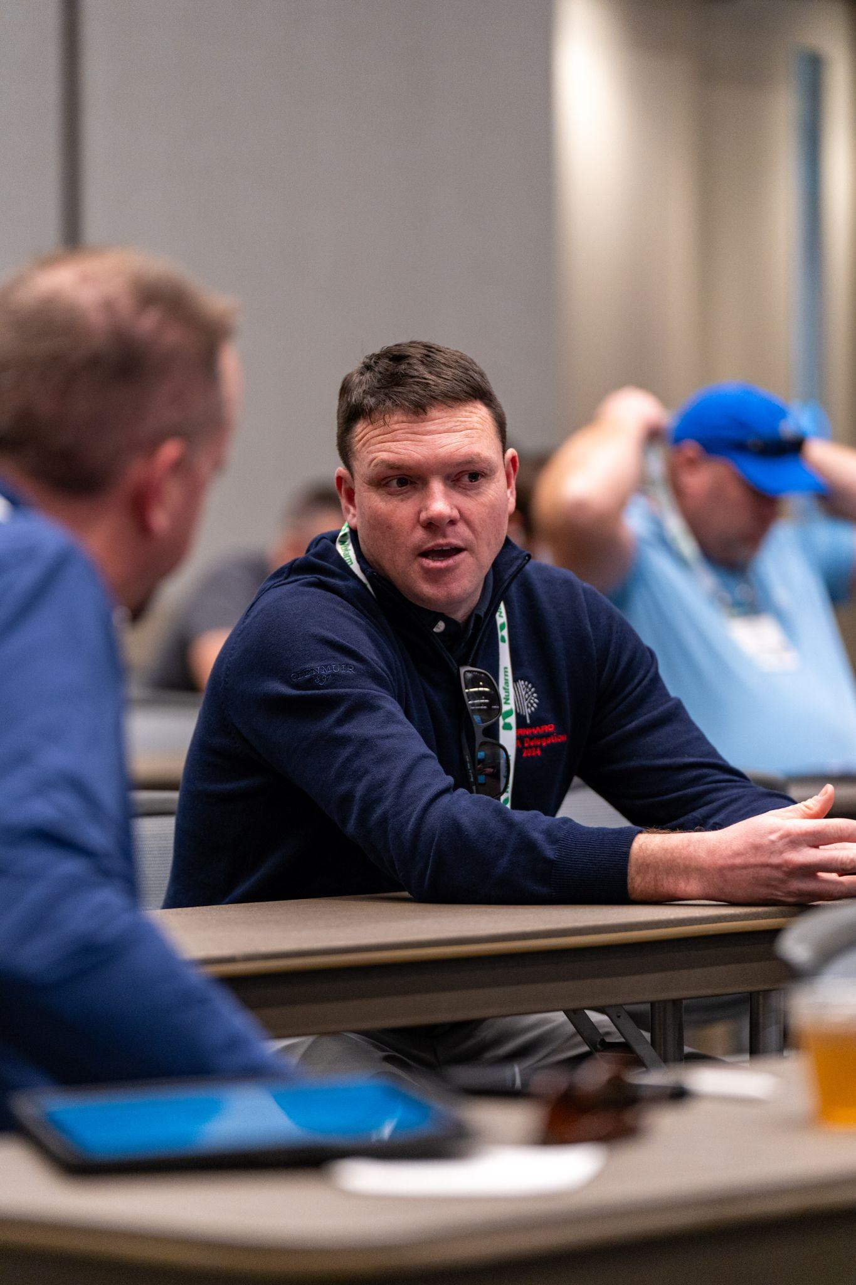
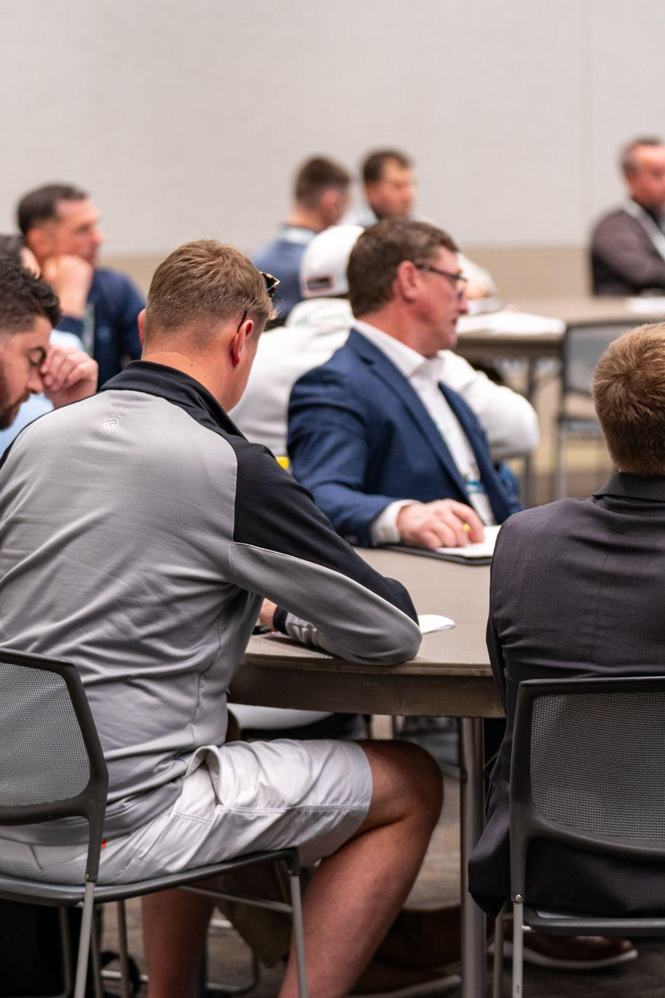
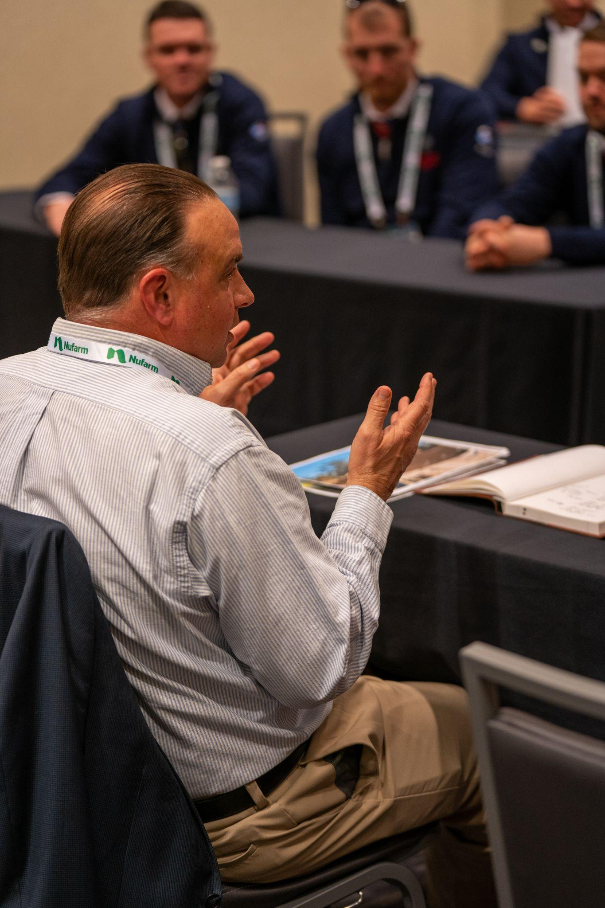
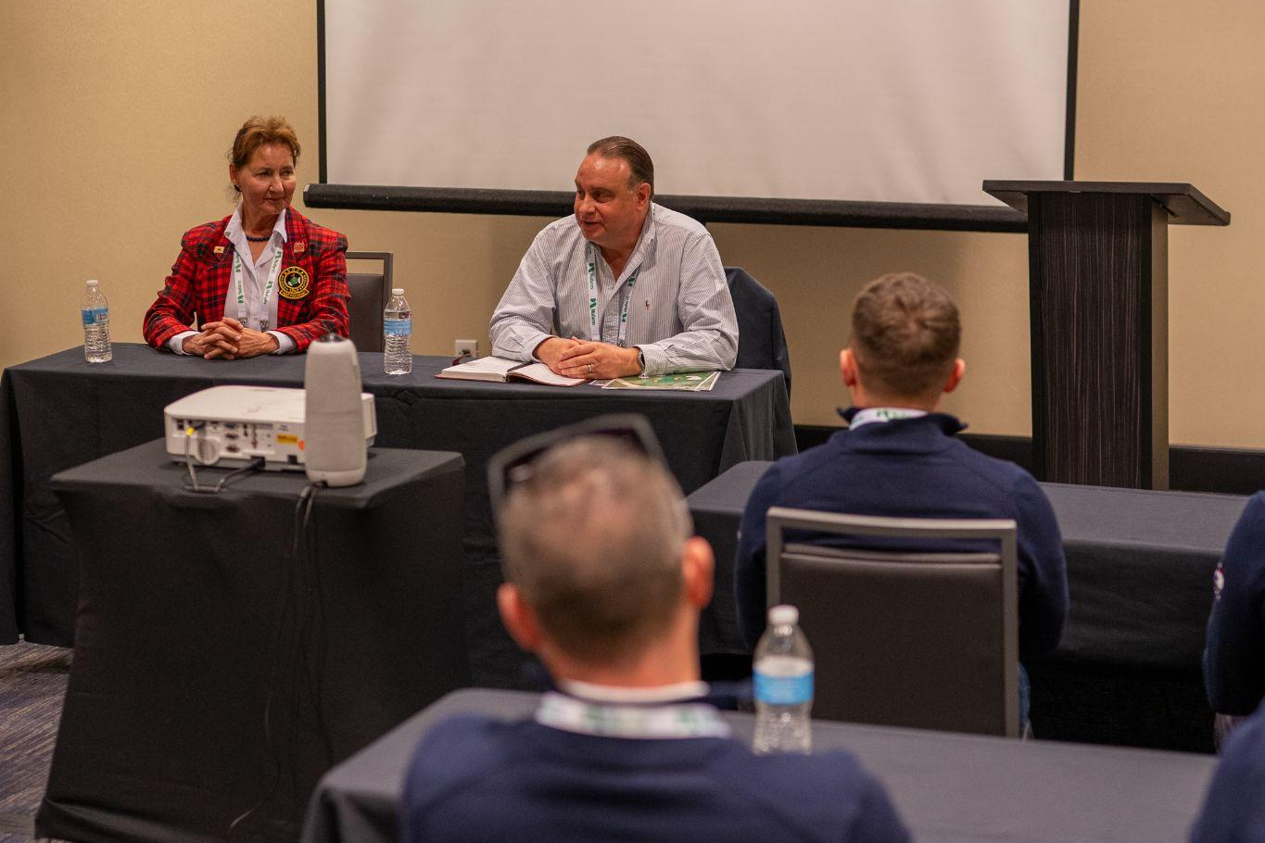
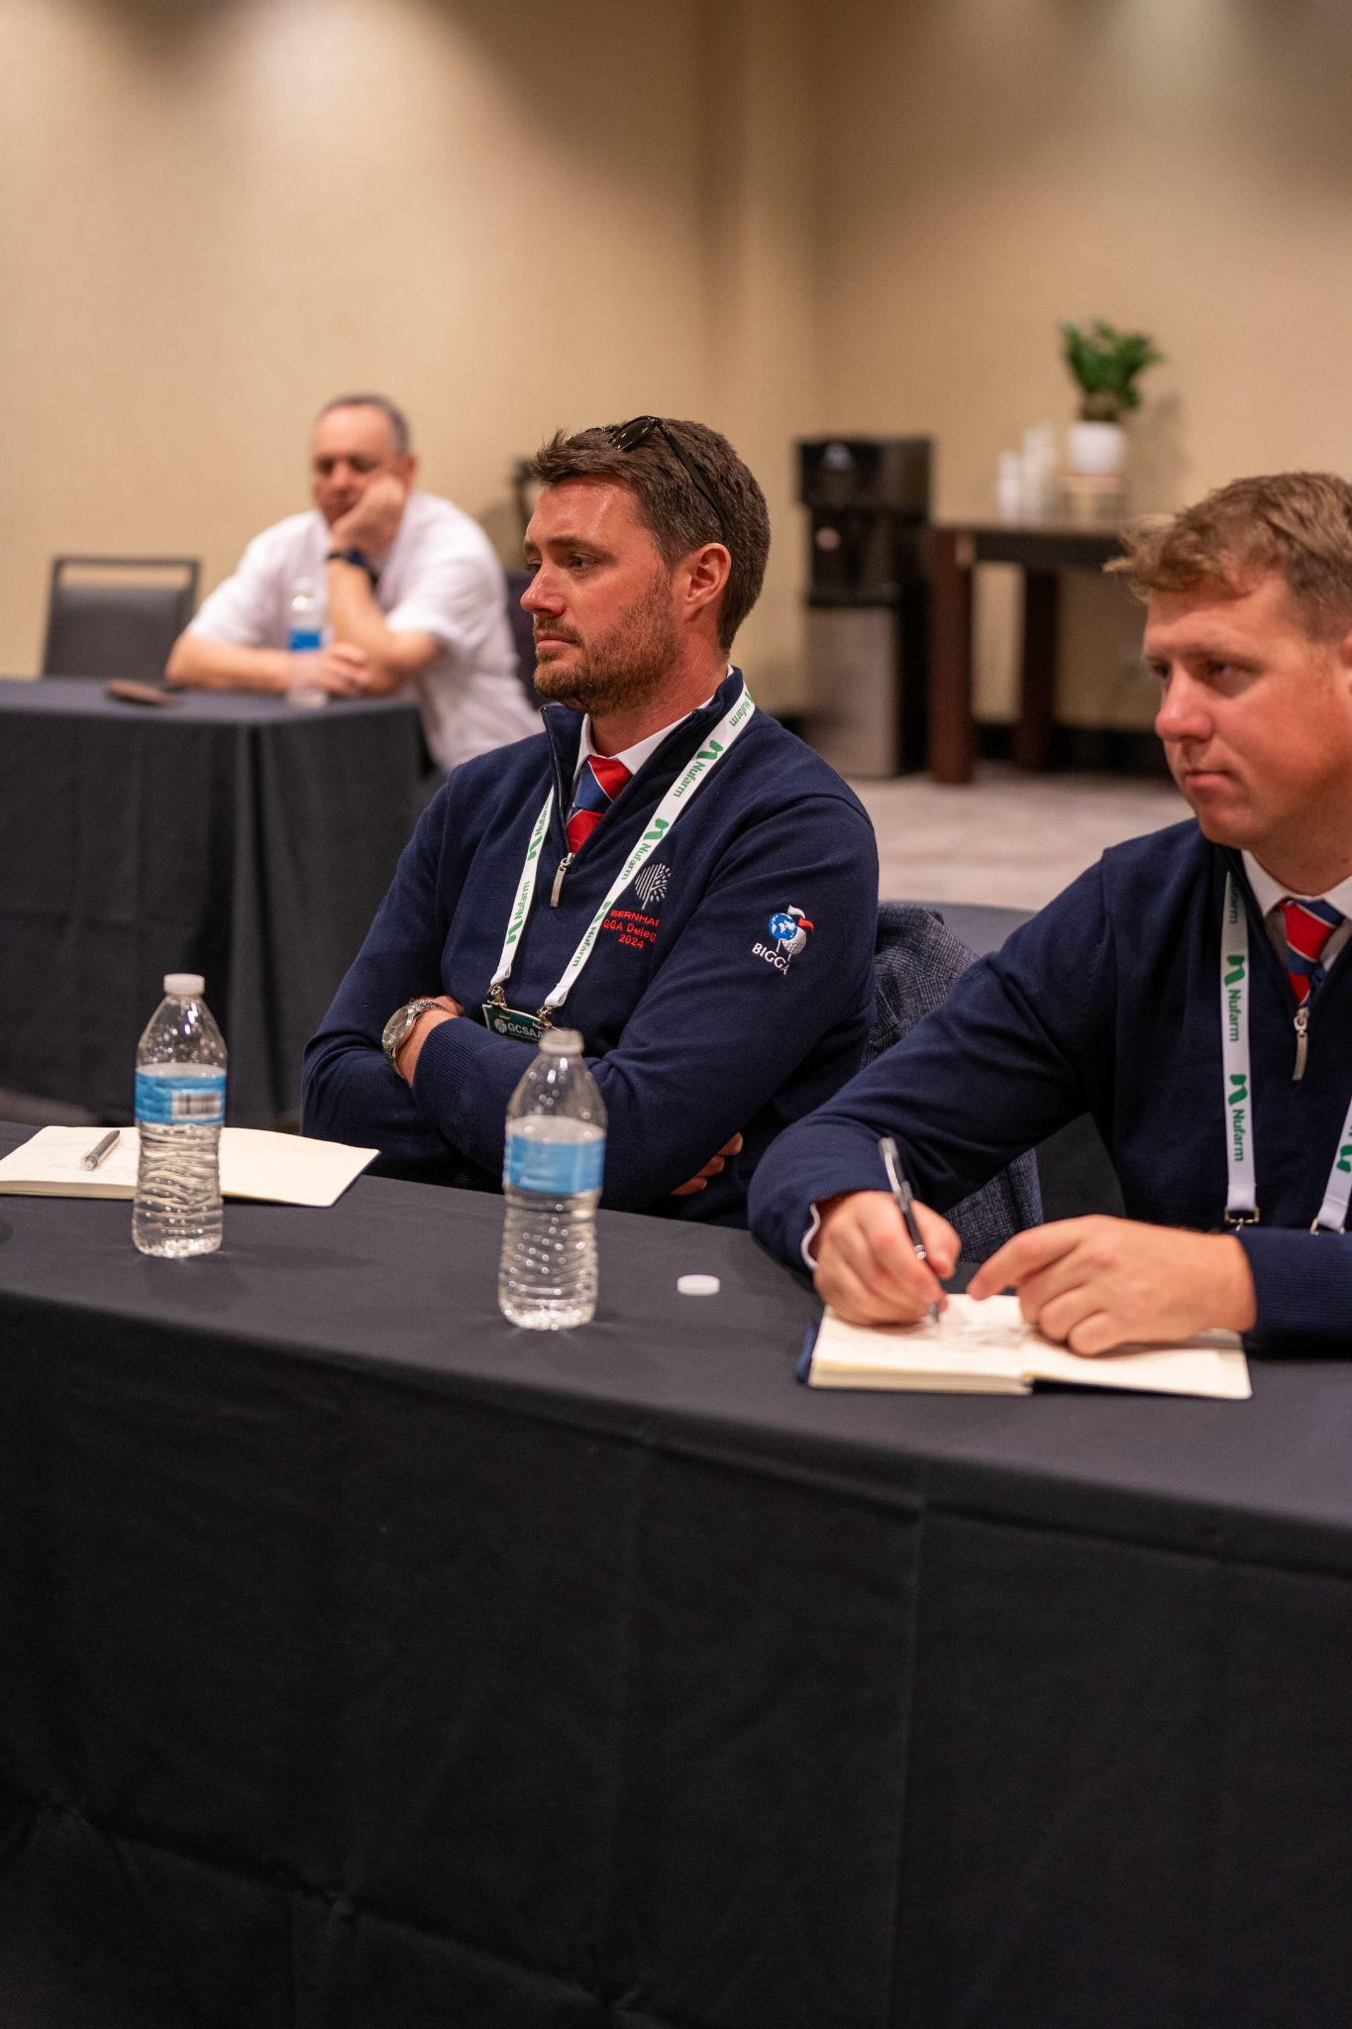
LINKS TO SUCCESS WEBINAR
Past Delegate Experience

Slide 15
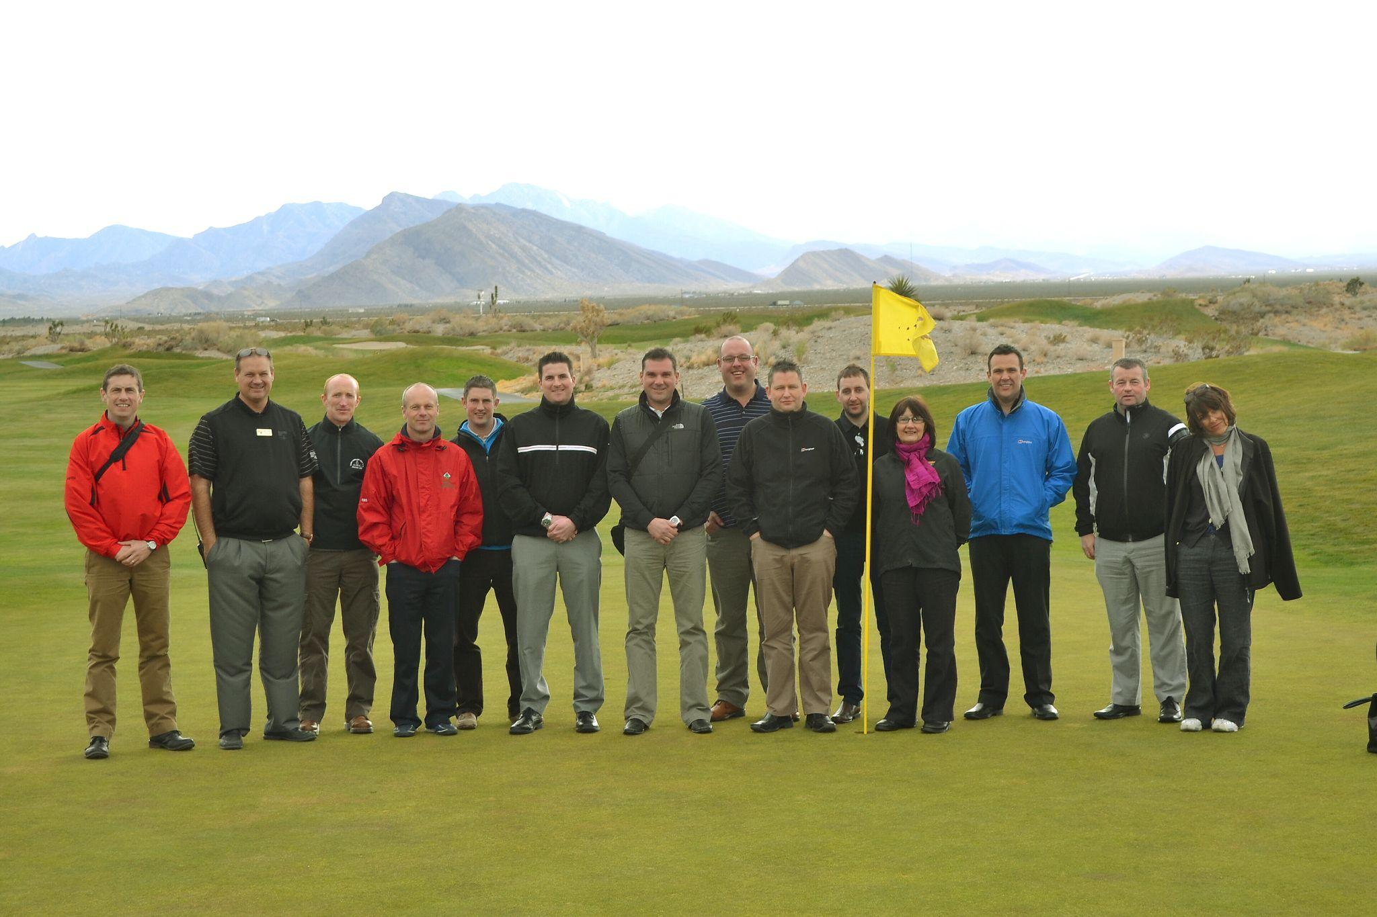
LINKS TO SUCCESS WEBINAR
Past Delegate Experience
Stuart Hall
Customer Care Manager, Bernhard and Company
Past Delegate - Vegas 2012

Slide 16
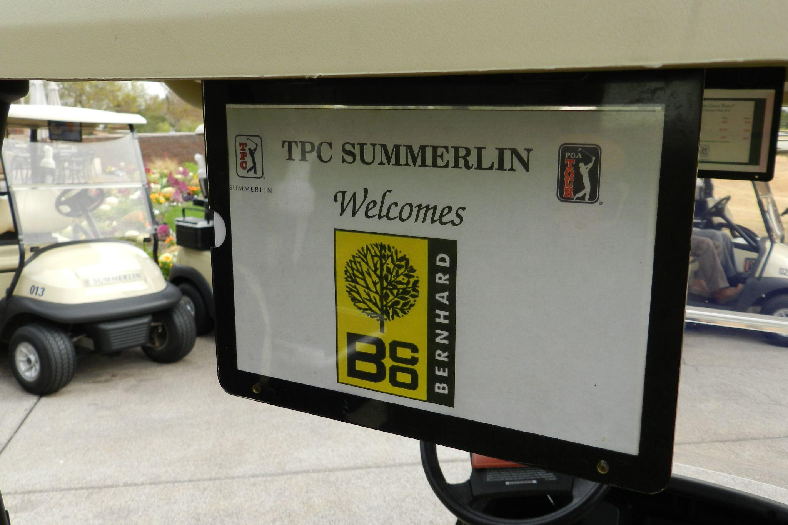
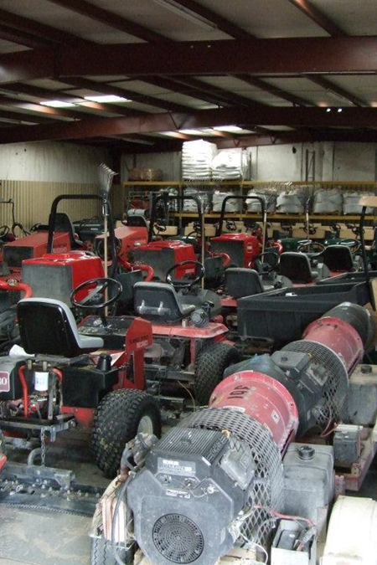
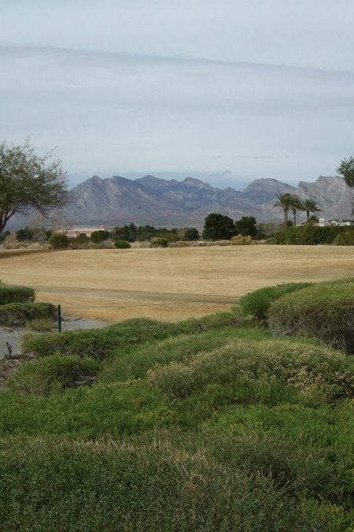
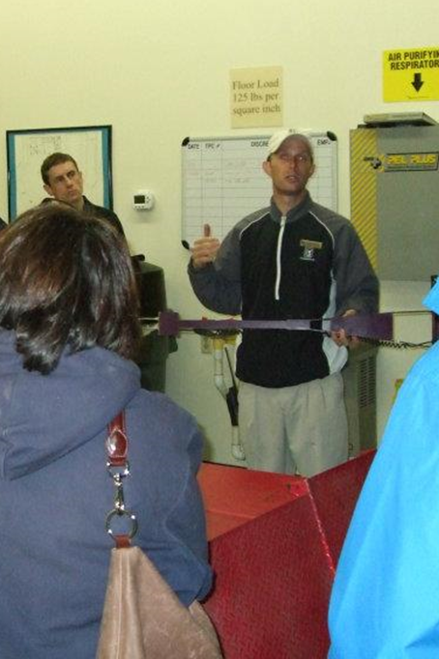
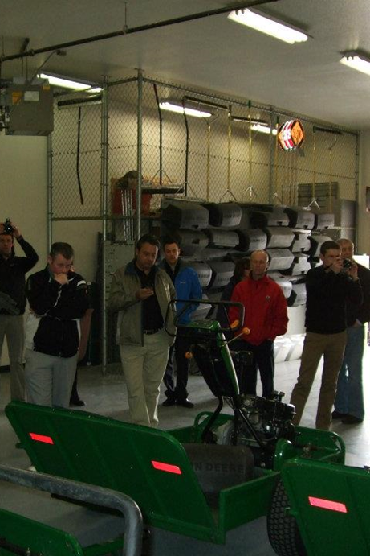
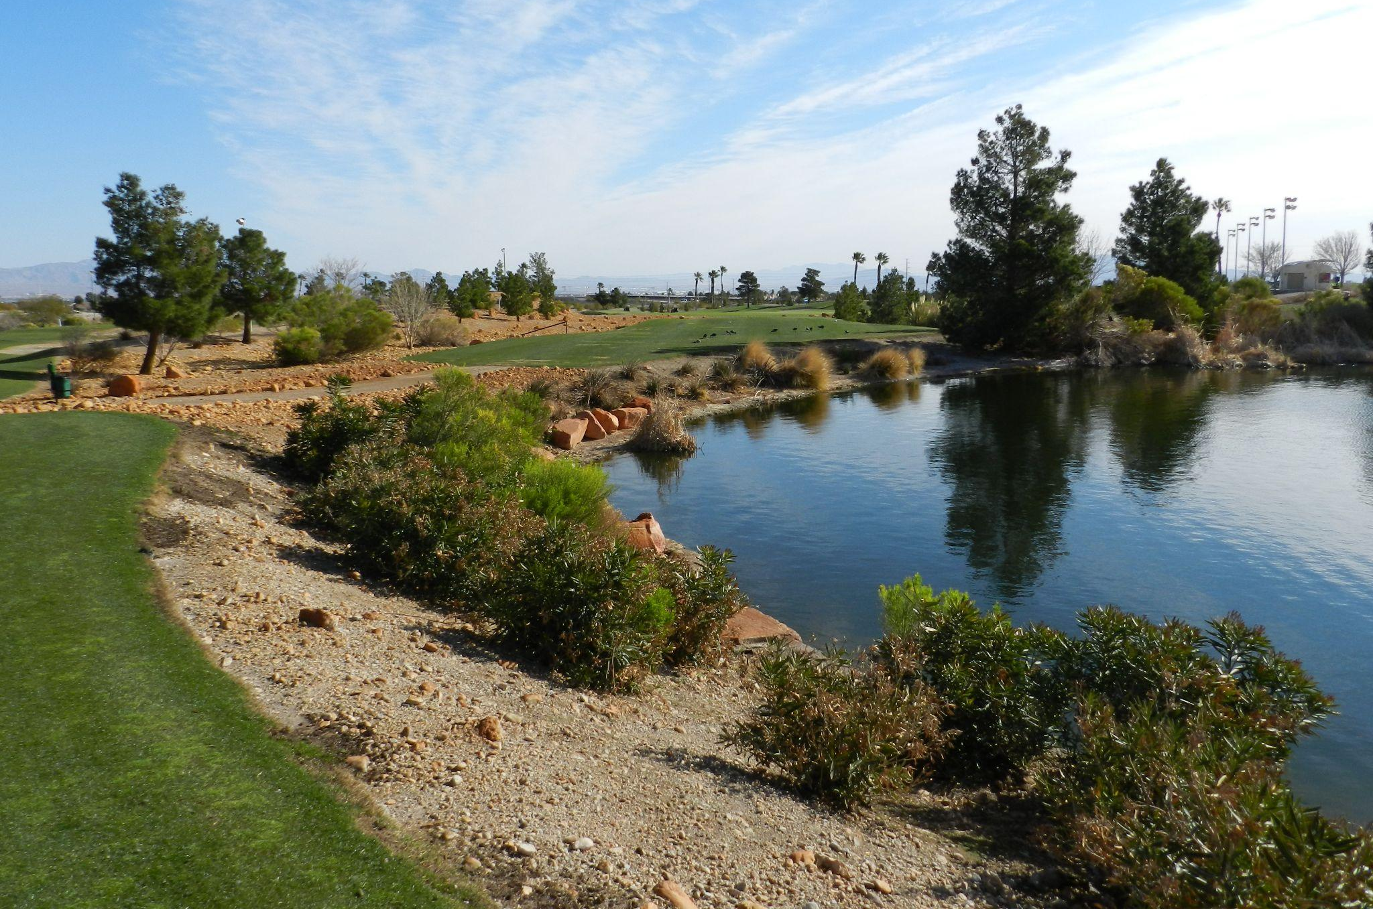
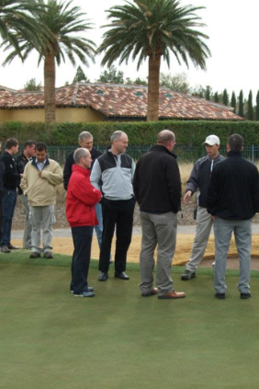
LINKS TO SUCCESS WEBINAR
Past Delegate Experience

Slide 17
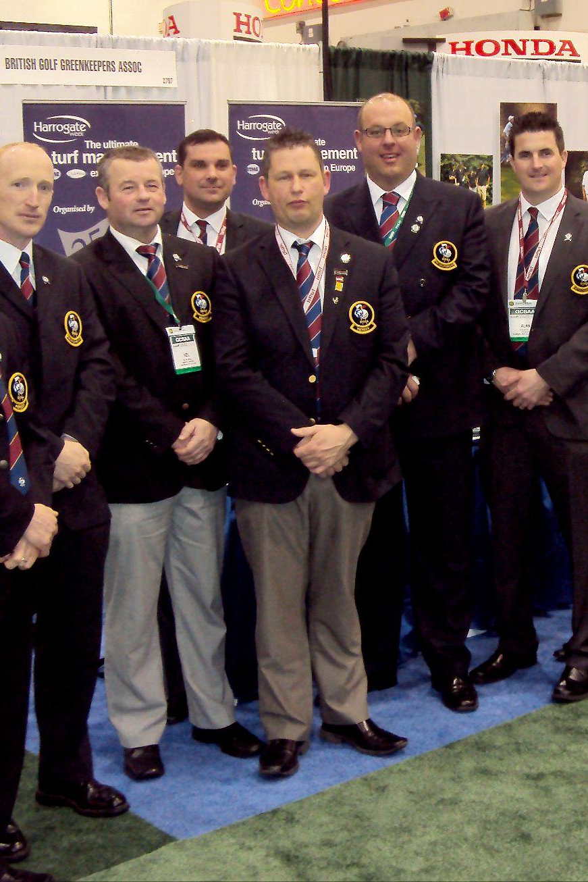
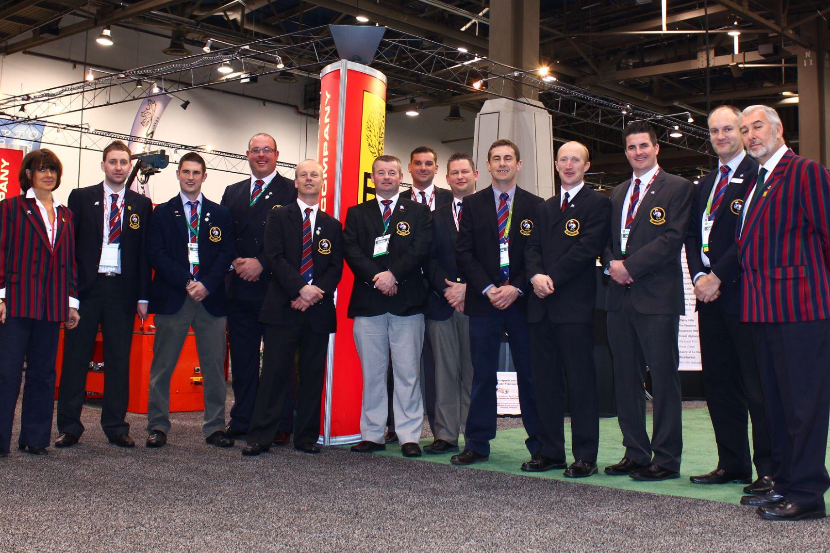
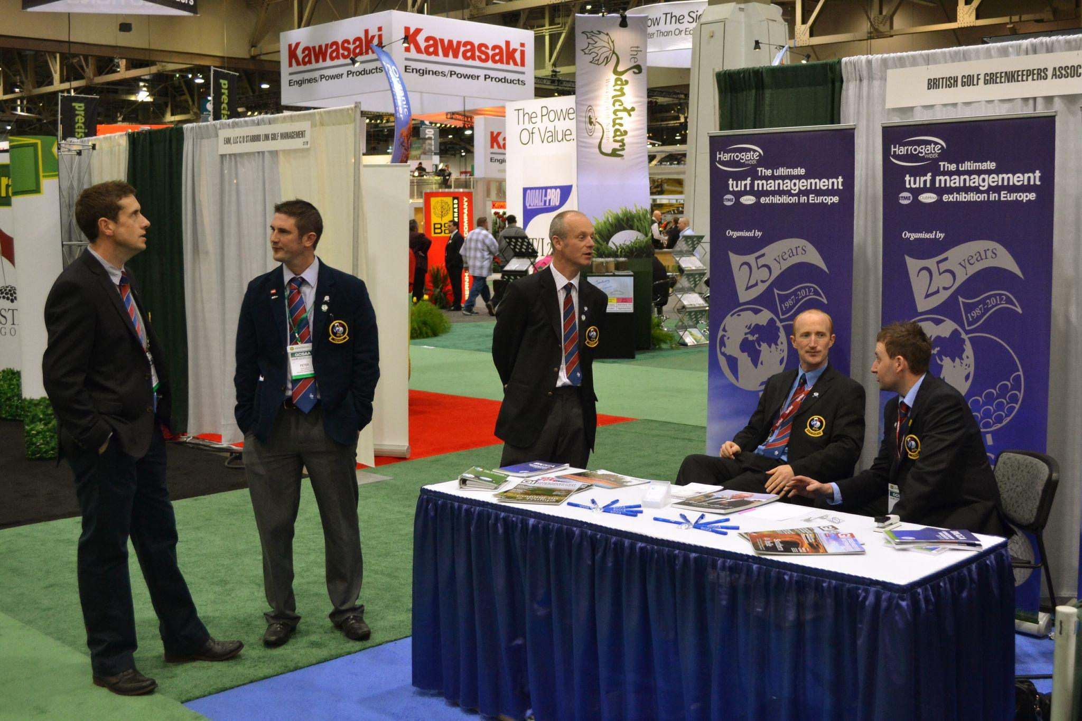
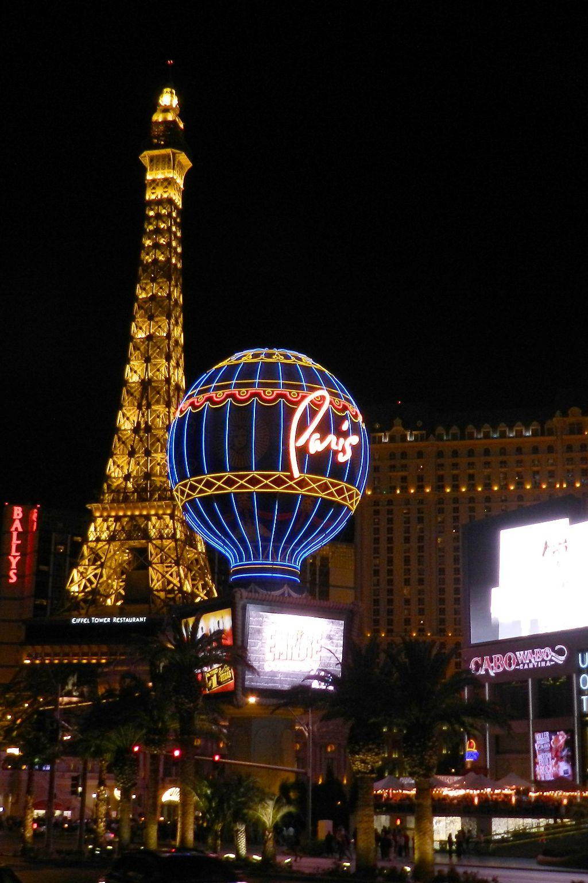
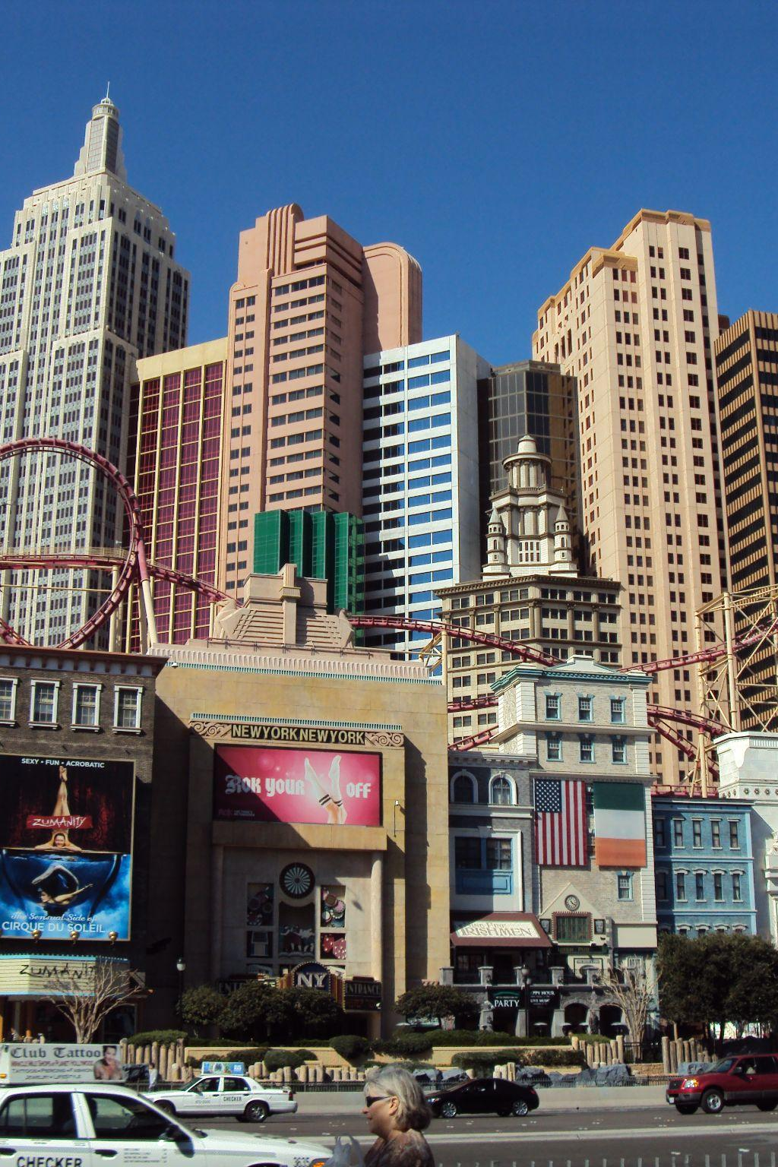
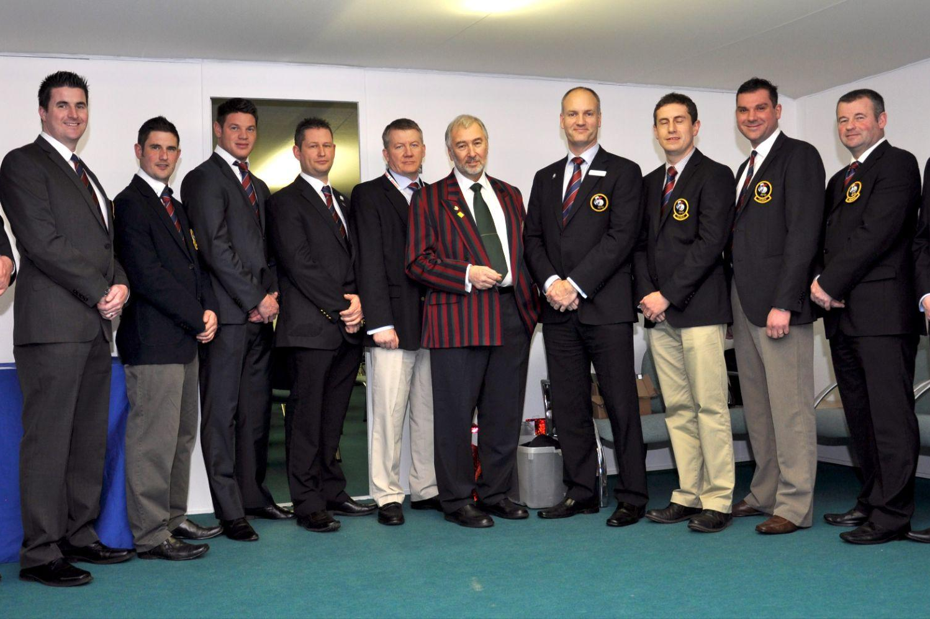
LINKS TO SUCCESS WEBINAR
Past Delegate Experience

Slide 18
APPLICATION
PROCESS
PAST DELEGATE EXPERIENCE

Slide 19
LINKS TO SUCCESS WEBINAR
Eligibility
The following member classes are eligible to apply:
GCSAA members working in North America are eligible to apply.
CLASS
A
CLASS
B
CLASS
C
CLASS
EM

Slide 20
LINKS TO SUCCESS WEBINAR
Application Process
Application is open and can be found at www.gcsaa.org/foundation/education/links-to-success
Timeline:
MAY 31
APPLICATIONS CLOSE.
JUN 5 - 15
INITIAL JUDGING OF APPLICANTS.
JUN 17 - 21
TOP 20 CANDIDATES WILL MOVE FORWARD.
All applicants will be notified by email of their status.
JUN 24 - JUL 5
FINALISTS WILL SEND 3 MINUTE VIDEO OF THEMSELVES.
Also confirm available dates for Zoom interviews.
JUL 15 - 26
ZOOM INTERVIEWS WILL BE CONDUCTED.
AUG 5
THE TEN 2025 DELEGATES WILL BE SELECTED.
AUG 9
DELEGATES WILL BE NOTIFIED.
AUG 13
ANNOUNCEMENT OF THE DELEGATION WILL GO OUT.

Slide 21
ANY
QUESTIONS?
PAST DELEGATE EXPERIENCE

Slide 22
THANKS FOR
PARTICIPATING
APPLY NOW
PAST DELEGATE EXPERIENCE

